Slide 1
New Kits to Teach CRISPR:
Both Hands-On and Online
explorer.bio-rad.com | explorer@bio-rad.com

Slide 2
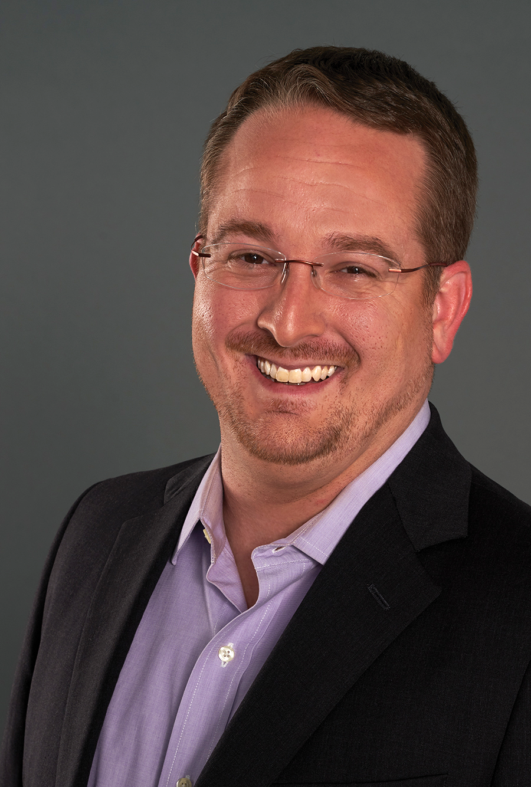
Speaker
Q&A Moderator
Ian Harwood, PhD
Product Manager
Delquin Gong, PhD
Senior Scientist

Slide 3
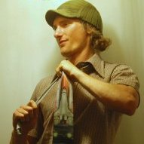
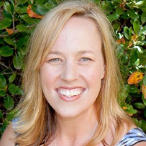
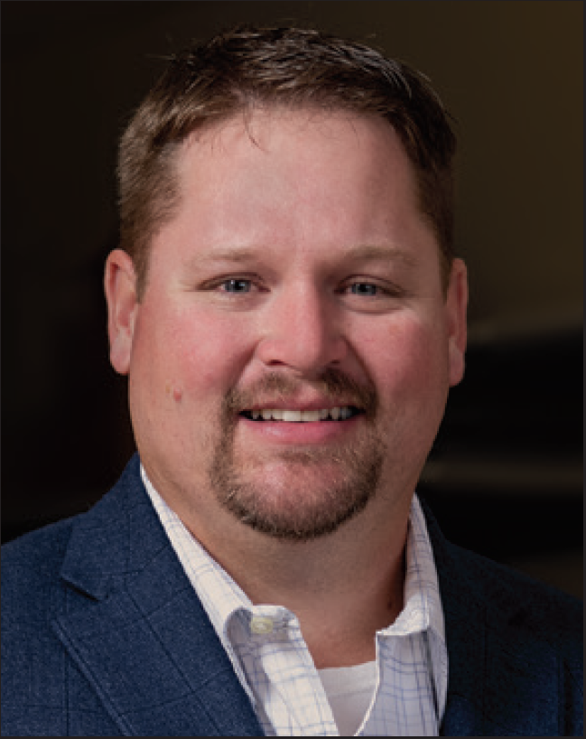
Support Specialists
Damon Tighe
Leigh Brown
Tamica Stubbs
Aaron Kallas
explorer@bio-rad.com

Slide 4
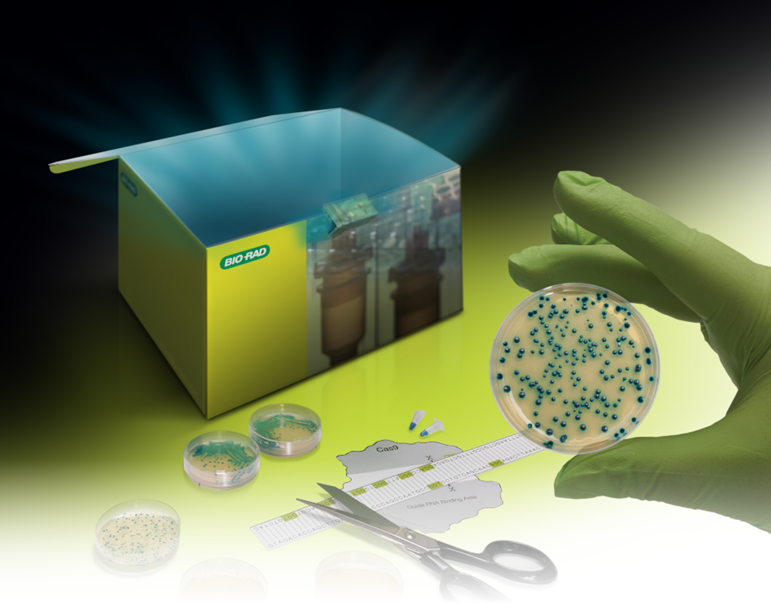
Out of the Blue CRISPR and Genotyping Extension kits
bio-rad.com/outoftheblue

Slide 5
Why Teach CRISPR?
Microbial immune system
Discovery to technology
Applications
2020 Nobel Prize in Chemistry

Slide 6
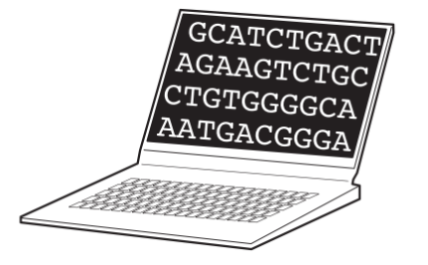
Topics, Skills, and Activities
Model
Calculate
Controls
Check
Create

Slide 7
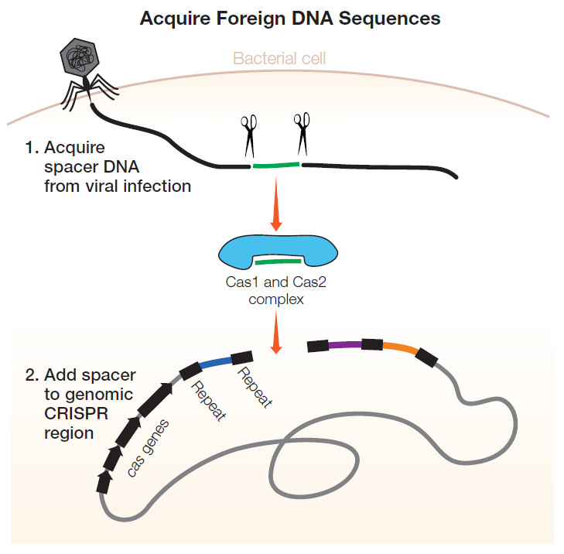
Bacterial Adaptive Immunity
Learn, Monitor, and Defend

Slide 8
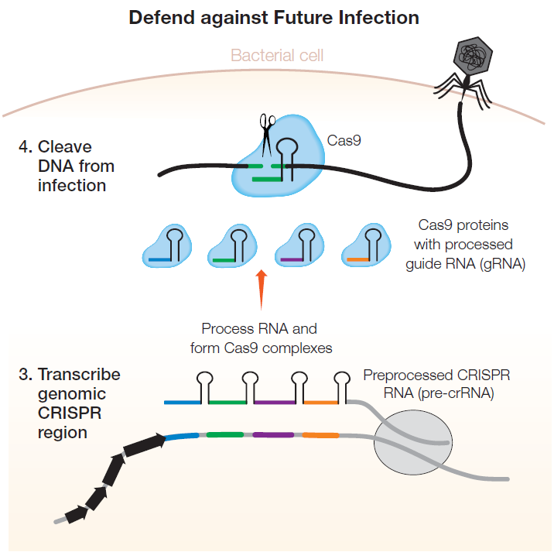
Bacterial Adaptive Immunity
Learn, Monitor, and Defend

Slide 9
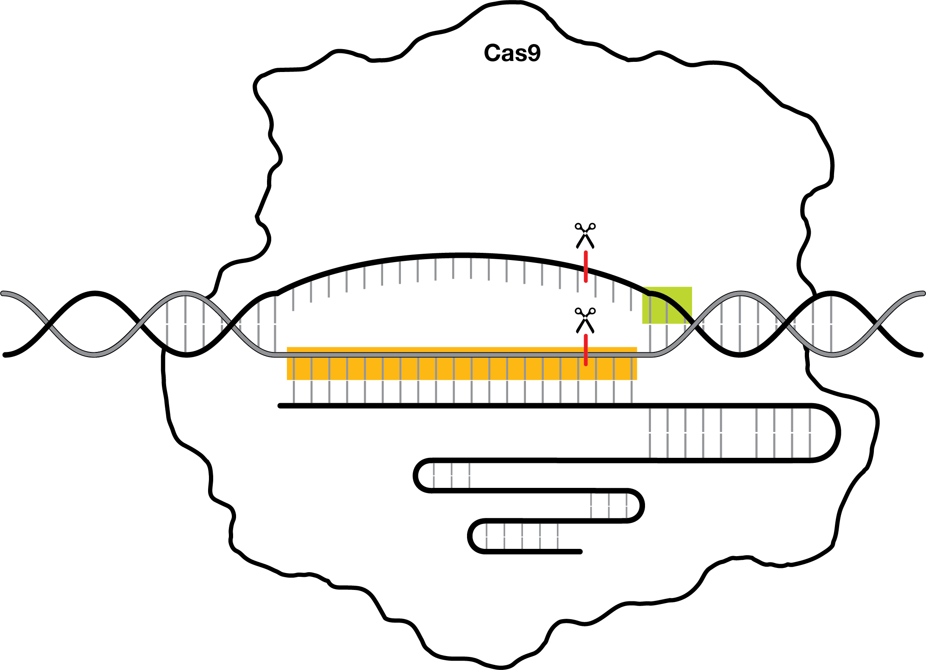
PAM
20 nucleotide sequence
Single guide RNA

Slide 10
Modeling!

Slide 21
Math!

Slide 22
Activity — Mathematical Modeling
From Out of the Blue CRISPR Kit Student Guide

Slide 23
Activity — Mathematical Modeling
How many times would you expect to find a specific 20 base pair sequence in the human genome?
→
times

Slide 24
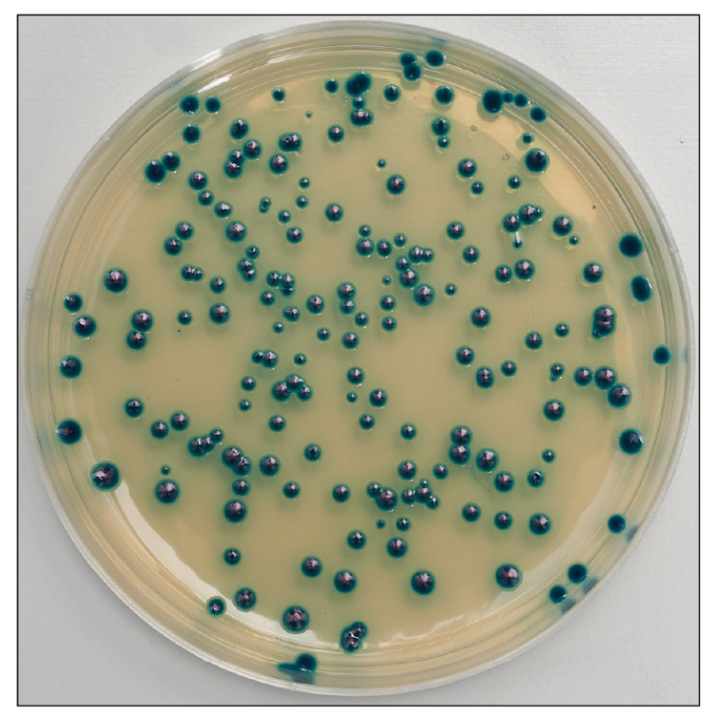
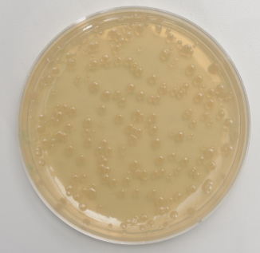
Hands-On:
Out of the Blue CRISPR Kit

Slide 25
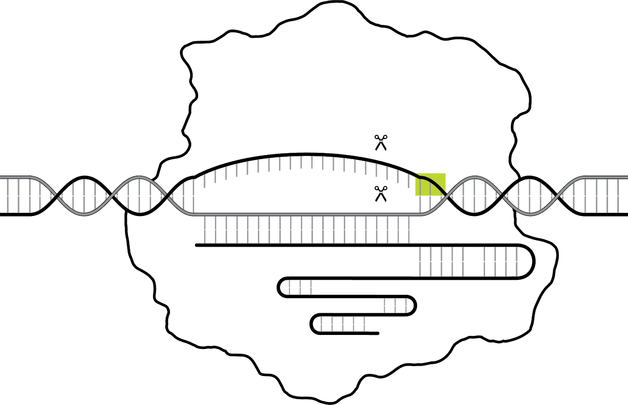
CRISPR-Cas9 Cut and Repair
Cut
Repair
Cas9-sgRNA complex
Homology directed repair
Non-homologous end joining

Slide 26
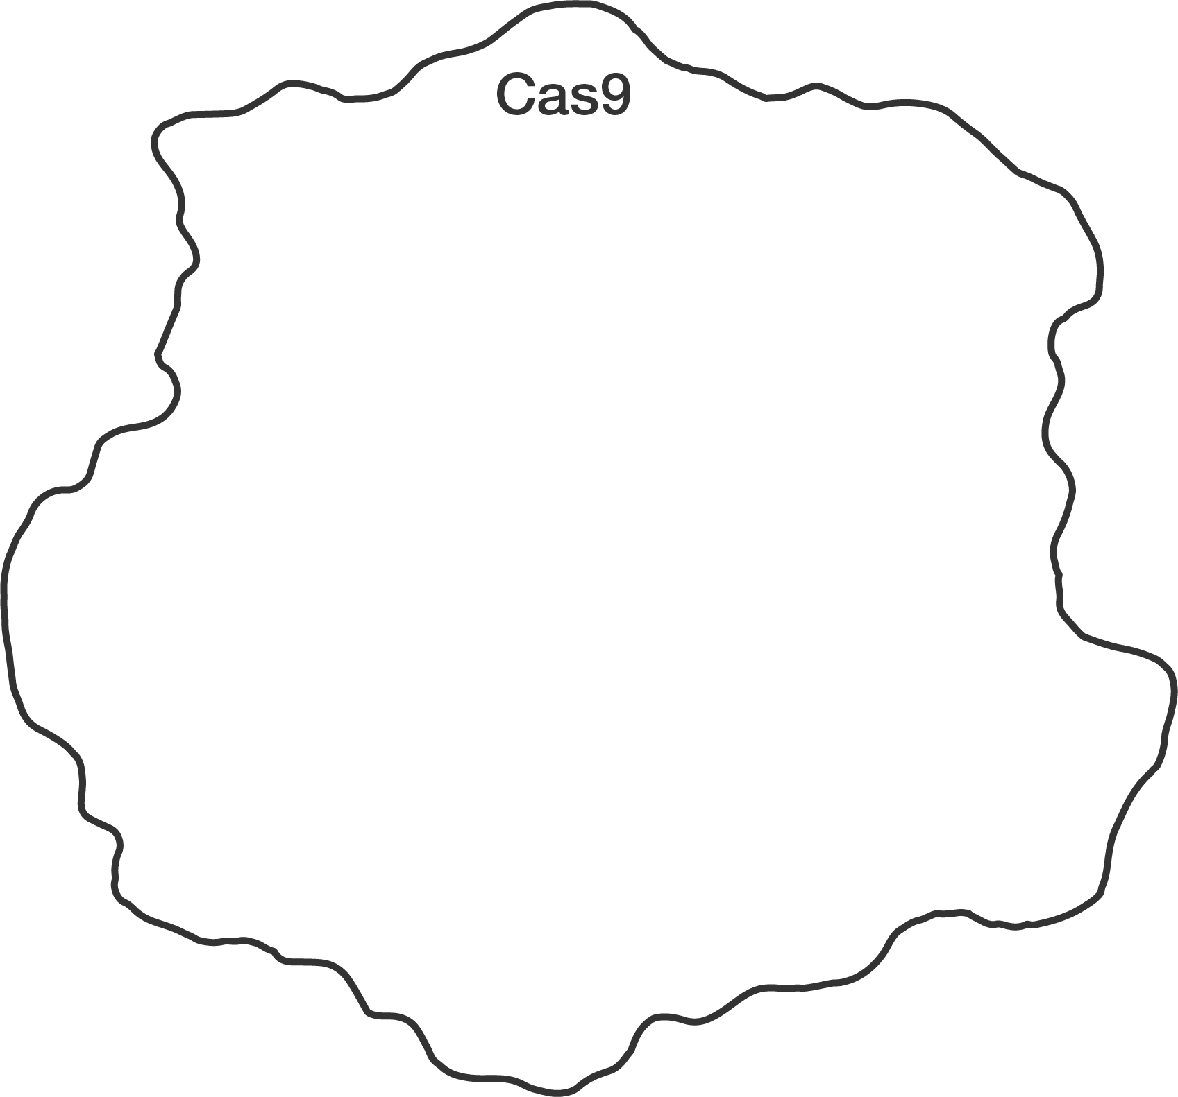
CRISPR-Cas9 Gene Editing
Cut
Repair
Cas9 protein

Slide 27
CRISPR-Cas9 Gene Editing
Cut
Repair
Single Guide RNA
(sgRNA)
Cas9-sgRNA complex

Slide 28
CRISPR-Cas9 Gene Editing
Cut
Repair
Target DNA

Slide 29
CRISPR-Cas9 Gene Editing
Cut
Repair
Cut site

Slide 30
CRISPR-Cas9 Gene Editing
Cut
Repair

Slide 31
Lethal Double-Strand Breaks (DSB)

Slide 32
CRISPR-Cas9 Gene Editing
Cut
Repair

Slide 33
CRISPR-Cas9 Gene Editing
Cut
Repair

Slide 34
CRISPR-Cas9 Gene Editing
Cut
Repair

Slide 35
CRISPR-Cas9 Gene Editing
Cut
Repair

Slide 36
CRISPR-Cas9 Gene Editing
Cut
Repair
Repair machinery
Homology directed repair

Slide 37
CRISPR-Cas9 Gene Editing
Cut
Repair
lacZ
lacZ
Homology directed repair

Slide 38
CRISPR-Cas9 Gene Editing
Cut
Repair
STOP
lacZ
Stop codon
lacZ
STOP
Homology directed repair

Slide 39
CRISPR-Cas9 Gene Editing
Cut
Repair
1. Cas9
3. Donor DNA
STOP
4. Repair machinery
STOP
2. Guide RNA

Slide 40
Controls!

Slide 41
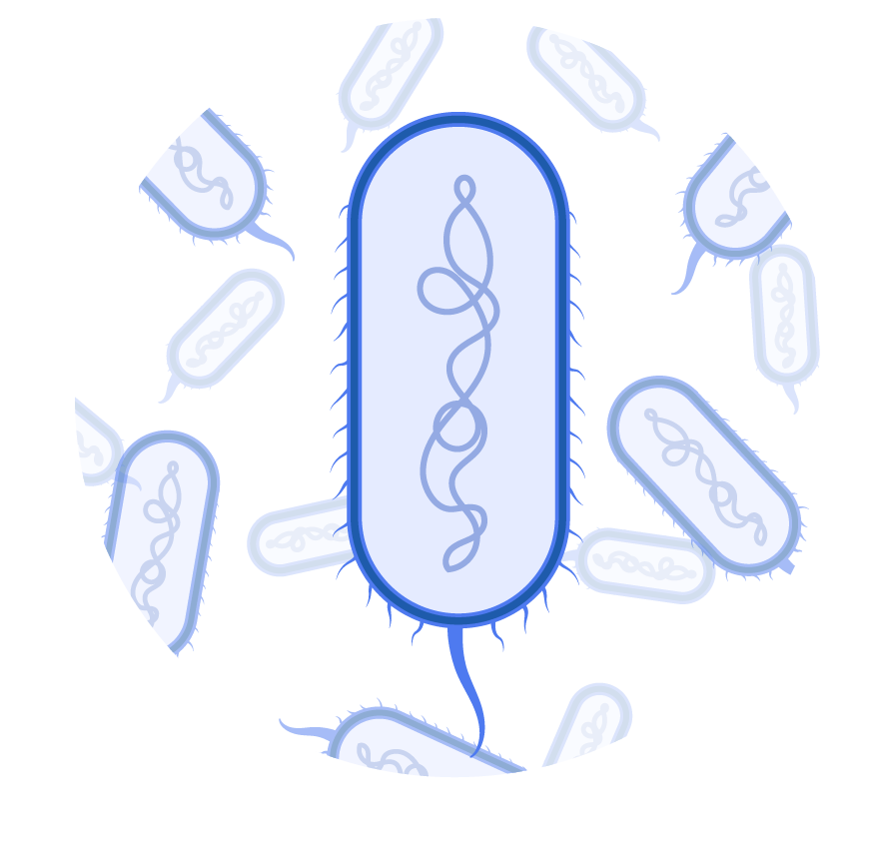
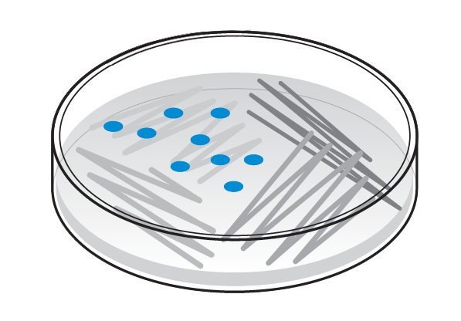
Cas9 expression

Slide 42
Arabinose Control of Repair Machinery
+ arabinose
– arabinose

Slide 43
Arabinose Control of Repair Machinery
Repair machinery ON
+ arabinose
– arabinose

Slide 44
Arabinose Control of Repair Machinery
Repair machinery ON
+ arabinose
Repair machinery OFF
– arabinose

Slide 45
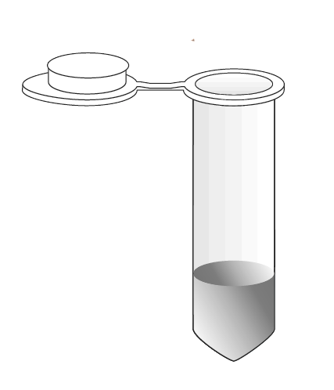
Available Plasmids
Donor DNA
sgRNA
pLZDonorGuide
(pDG)
pLZDonor
(pD)

Slide 46
Available Plasmids
Donor DNA
sgRNA
pLZDonorGuide
(pDG)
pLZDonor
(pD)

Slide 47
Available Plasmids
Donor DNA
sgRNA
pLZDonorGuide
(pDG)
pLZDonor
(pD)

Slide 48
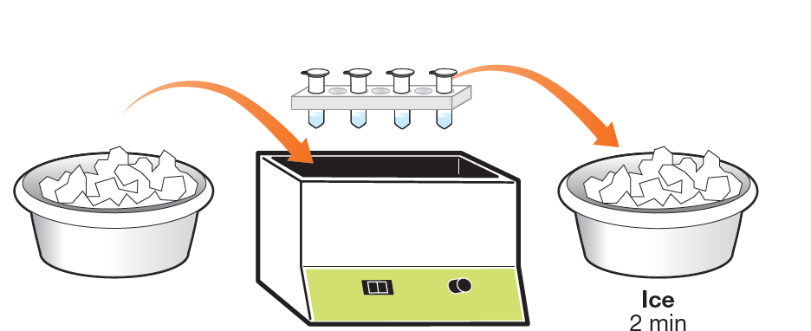
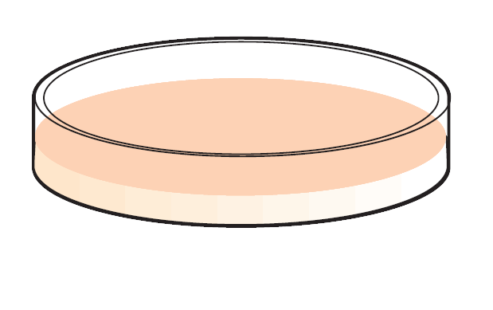
Hands-On:
Out of the Blue CRISPR Kit
Starter bacteria
(+/- DNA repair)
Plasmid
(+/- guide
RNA)
Transform
Plate

Slide 49
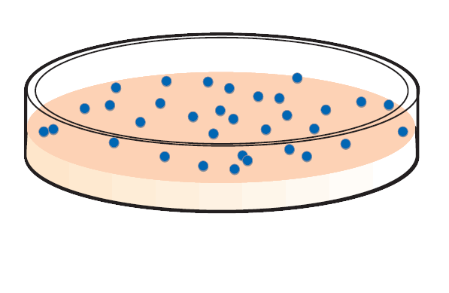
Anticipated Results?
pD
pDG
+ Donor DNA
+ Donor DNA
+ sgRNA
IX
Cut?
Cut?
A
B
– repair machinery
Repair?
Repair?
IX-Ara
Cut?
Cut?
C
D
+ repair machinery
Repair?
Repair?

Slide 50
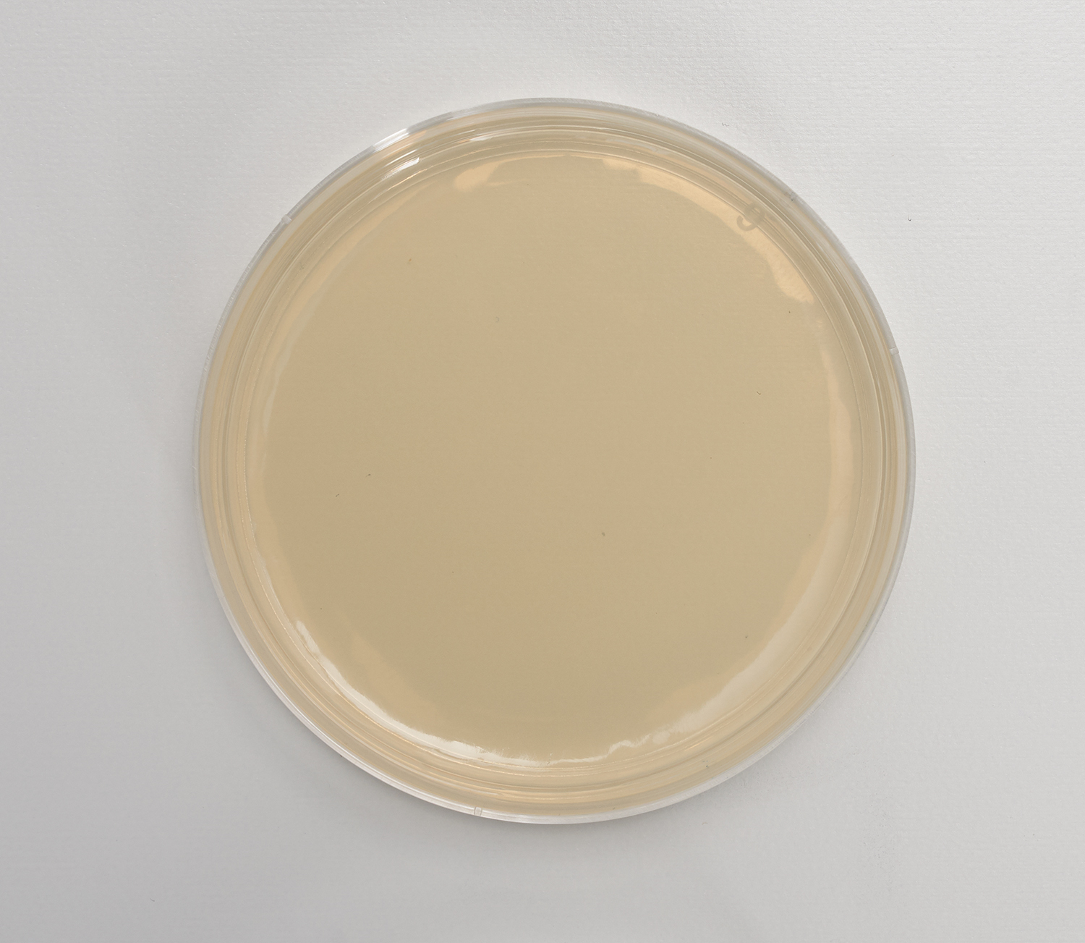
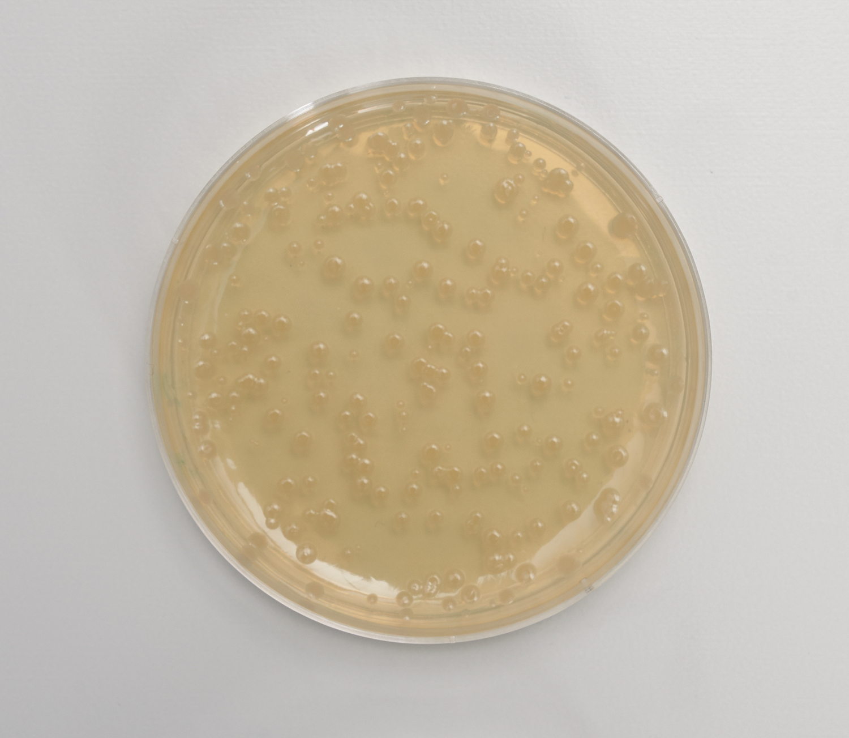
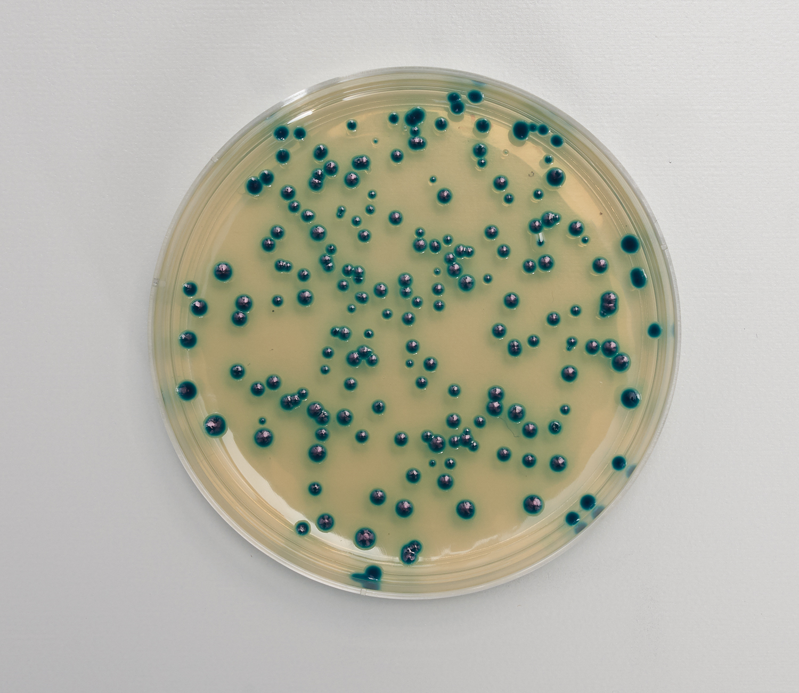
Example Results

Slide 51
Example Results

Slide 52
Example Results

Slide 53
Example Results

Slide 54
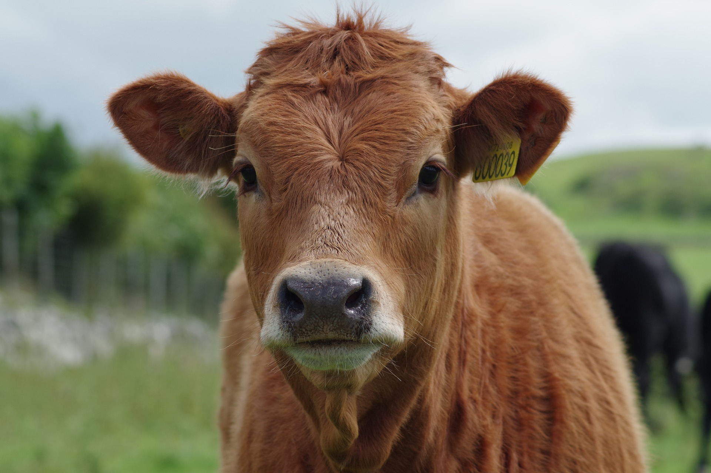
Gene-Edited Hornless Cattle and Genotyping

Slide 55
Check!

Slide 56
Explaining Results

Slide 57
Out of the Blue Genotyping Extension
Extract chromosomal DNA
Amplify DNA by PCR
Electrophorese DNA

Slide 58
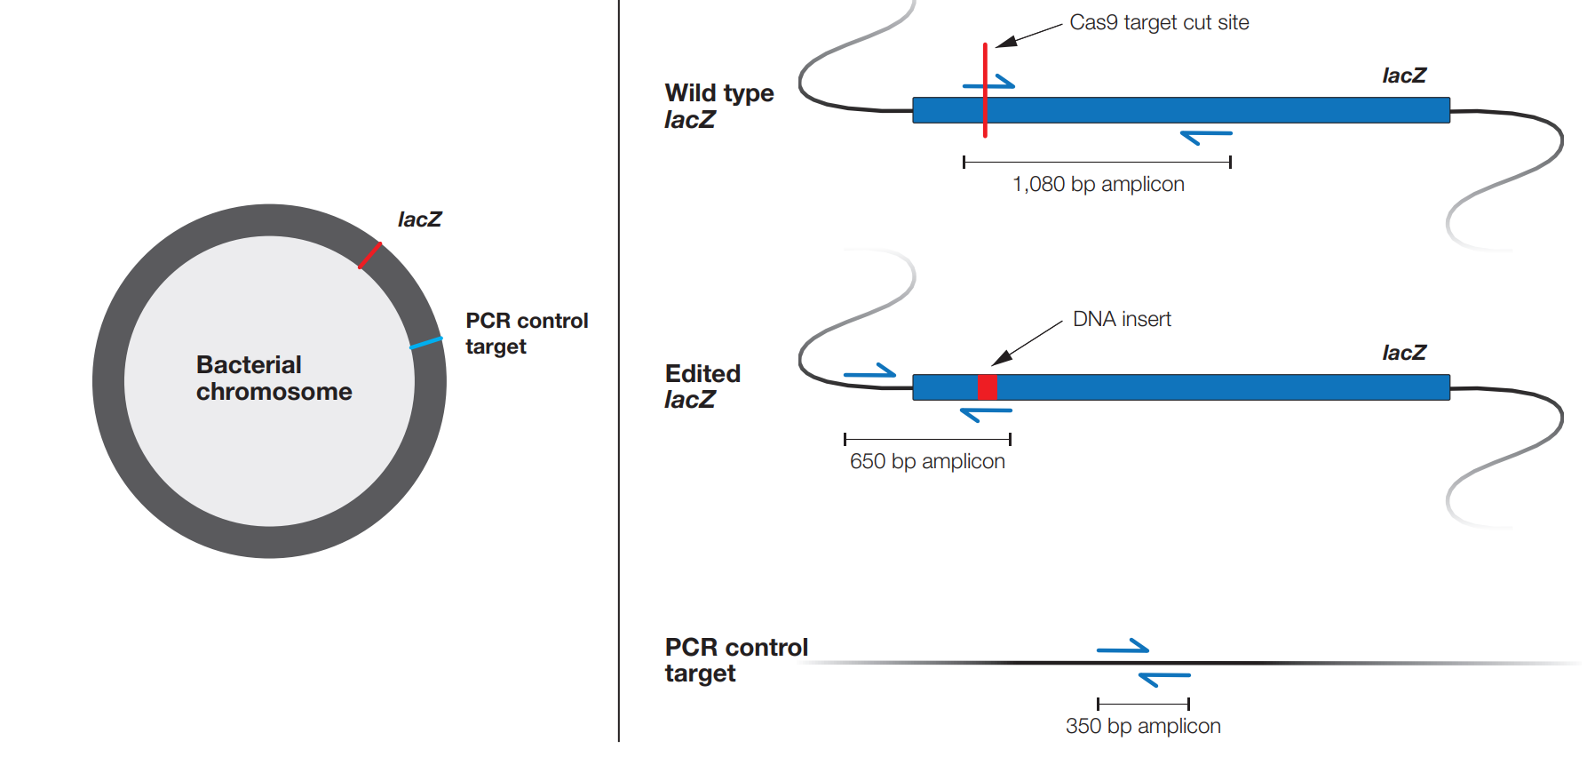
PCR Primers

Slide 59
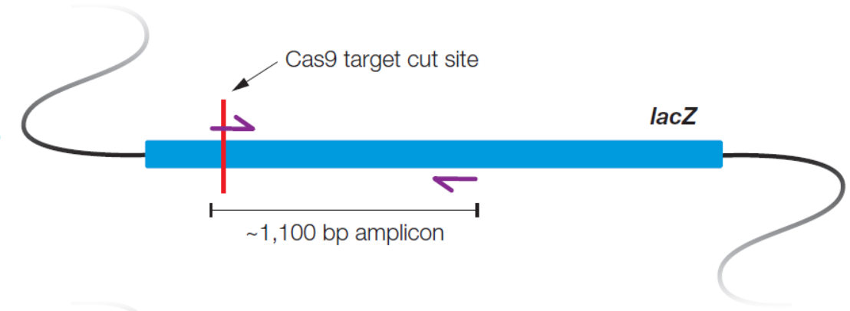
PCR Primer Set 1 – amplifies unmodified lacZ
target gene editing site

Slide 60
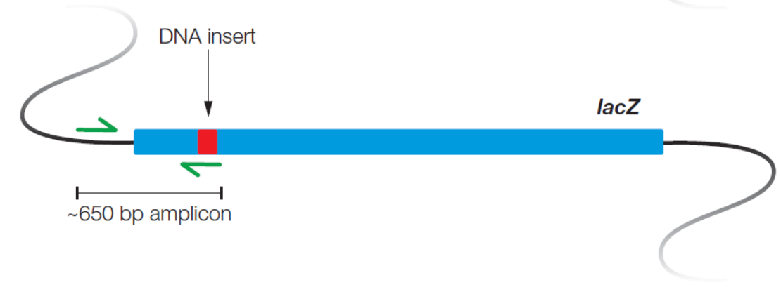
PCR Primer Set 2 – amplifies edited lacZ
insert

Slide 61
PCR Primer Set 3 – amplifies control DNA

Slide 62
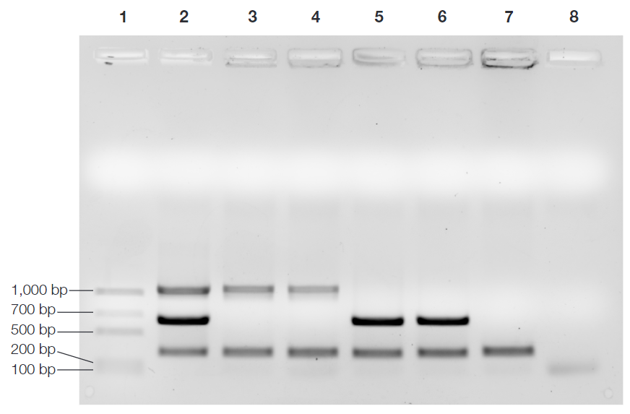
Sample results
Lane | Sample
1 | Molecular weight ruler (MWR)
2 | Positive PCR Control (+)
3 | PCR Sample Stater Plate
4 | PCR Sample Plate C
5 | PCR Sample Plate D Colony 1
6 | PCR Sample Plate D Colony 2
7 | PCR Sample Plate D Colony 3
8 | Negative PCR Control (–)

Slide 63
Create!

Slide 64
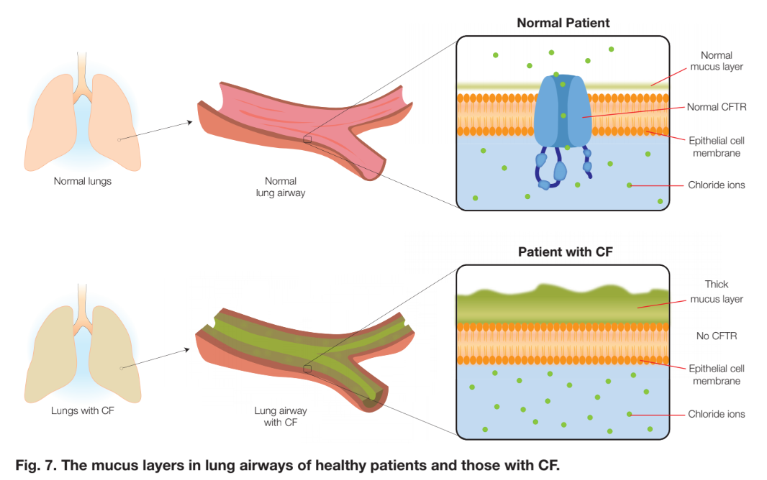
Capstone Project – Bioinformatics of Cas9 Target sites

Slide 65
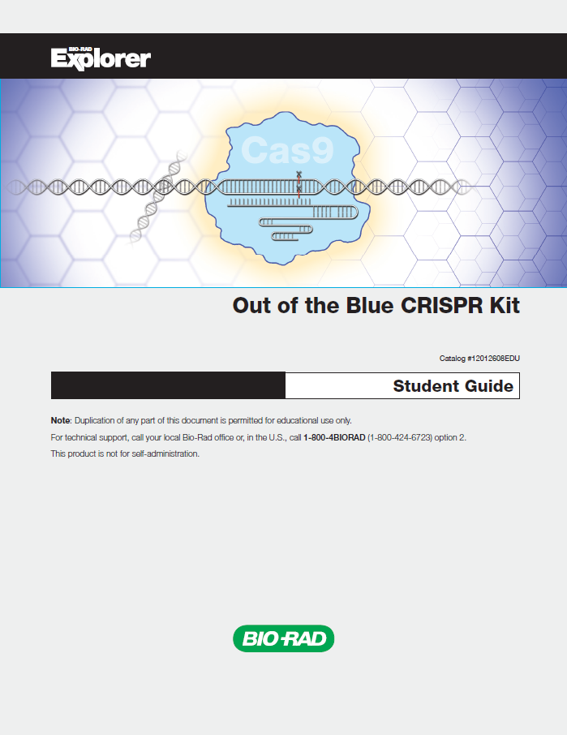
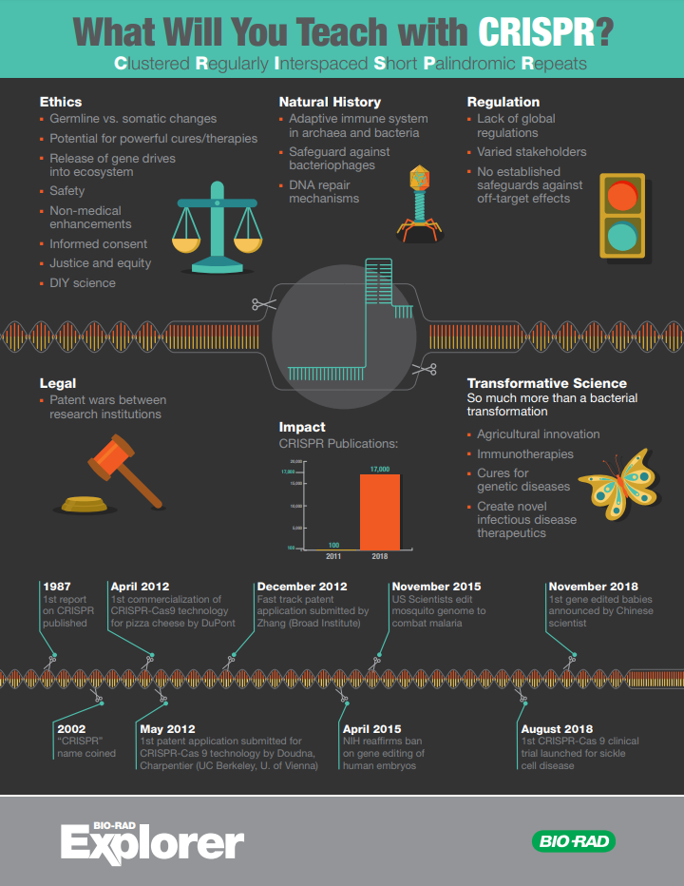
FREE Resources and Activities
bio-rad.com/outoftheblue

Slide 66
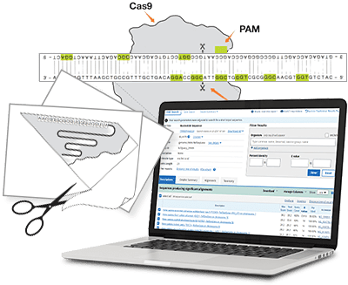
FREE Resources and Activities
bio-rad.com/teachcrispr

Slide 67
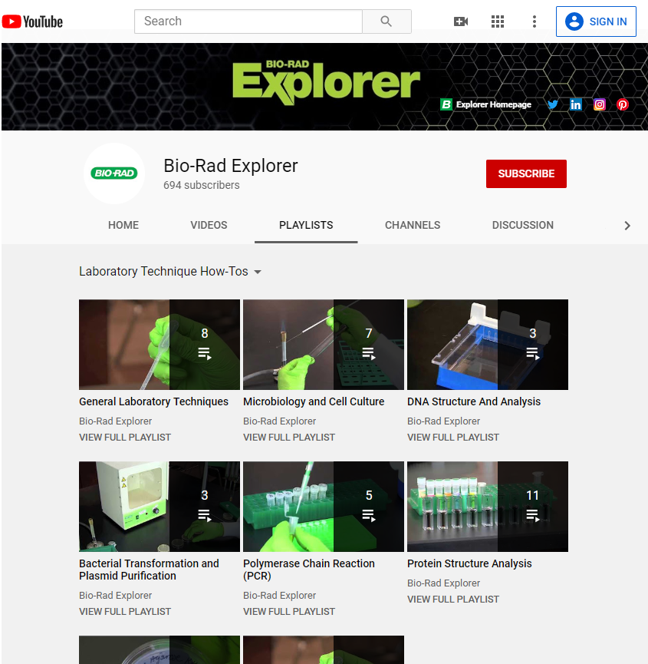
FREE Lab Technique Videos
bio-rad.com/explorervideos

Slide 68
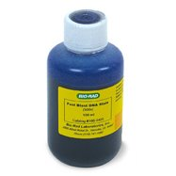
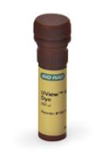
DNA Staining Options
UView
Nontoxic
Loading dye + Stain
View with UV
Instant results
Very sensitive
Fast Blast
Nontoxic
Stain only
Requires wait time
(5 min – overnight)
No UV needed (visible)
Less sensitive

Slide 69
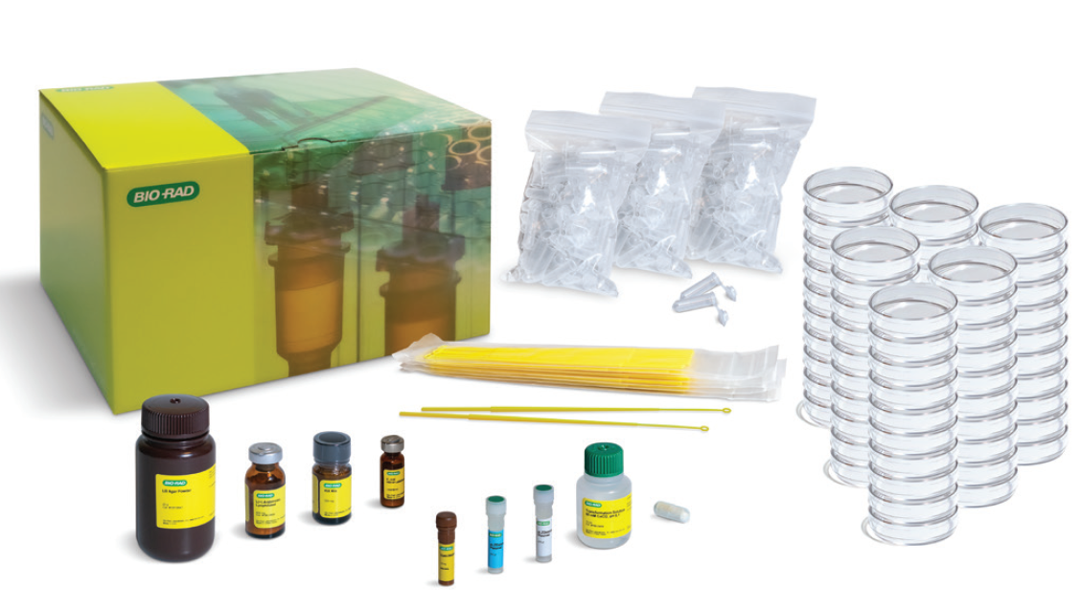
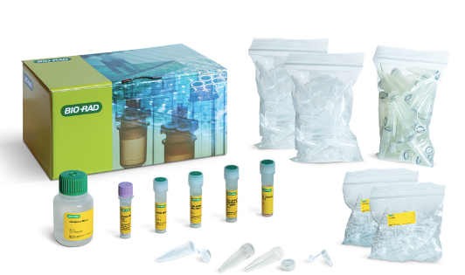
Ordering Information bio-rad.com/outoftheblue
Item | SKU | Contents | Price
Out of the Blue CRISPR Kit | 12012608EDU | reagents, growth media, plastics | $235
Out of the Blue CRISPR Refill | 12012620EDU | reagents | $199
Out of the Blue Genotyping Extension Kit | 12012607EDU | reagents, plastics | $199
Out of the Blue Genotyping Refill | 12012708EDU | reagents | $169
Discounted bundles available w/ both kits and/or with electrophoresis reagents

Slide 70
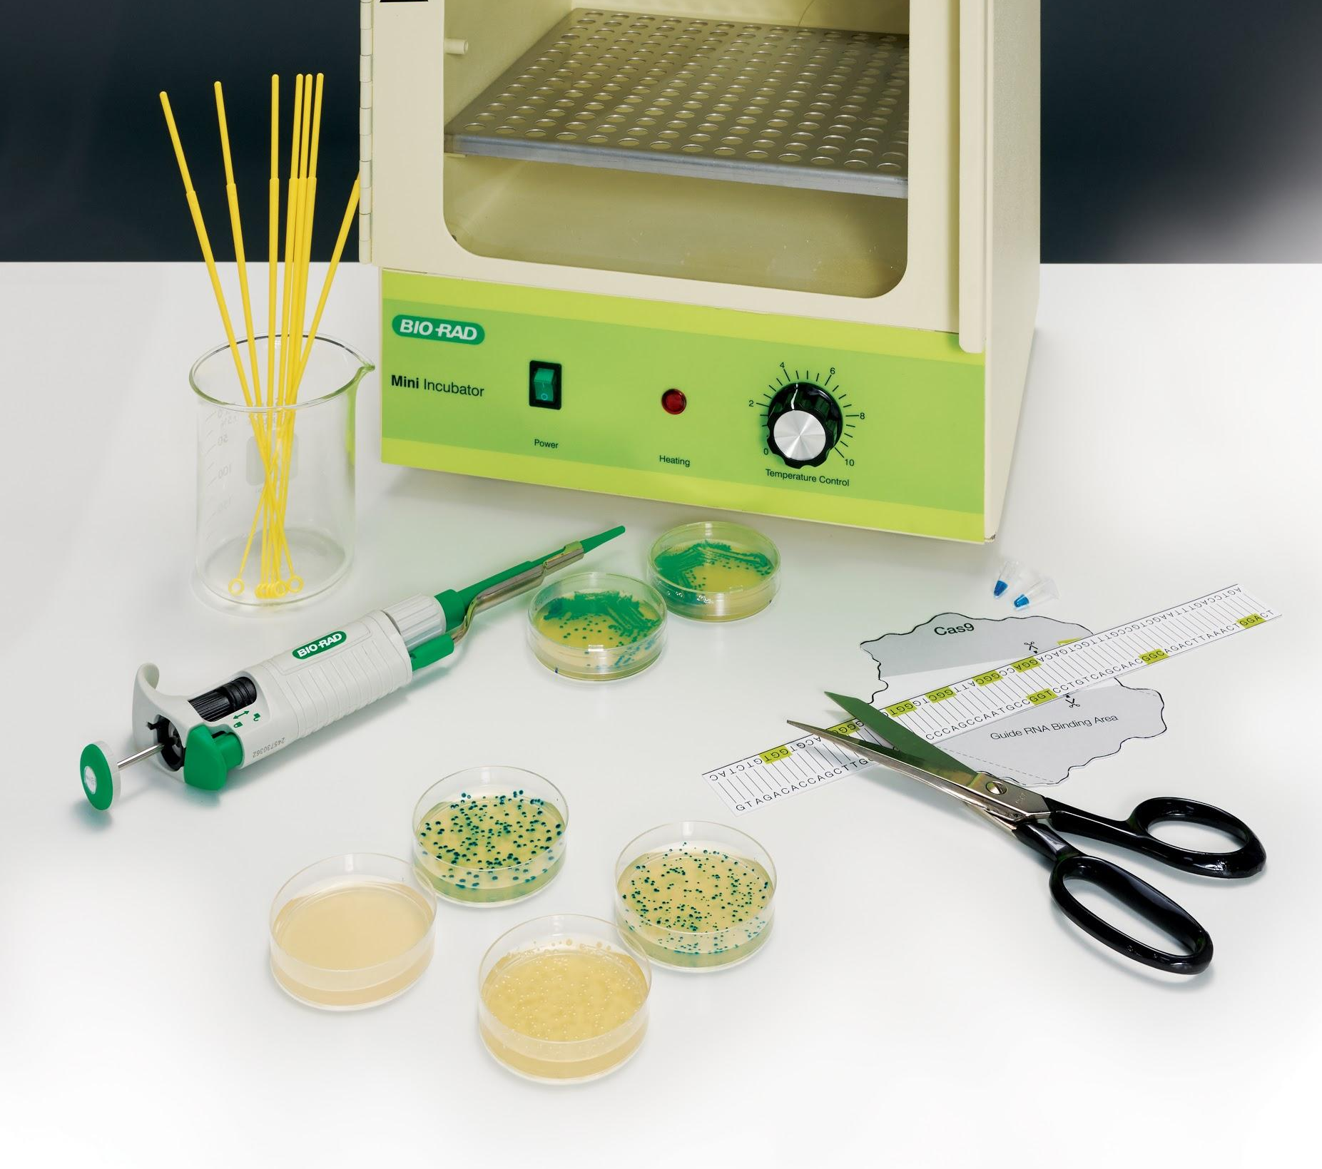
Remember: many Bio-Rad products are discounted for K-12 and undergrad classes!
More free resources:
bio-rad.com/classroomresources
For help visit bio-rad.com/explorerhelp
Thank you!

