Slide 1
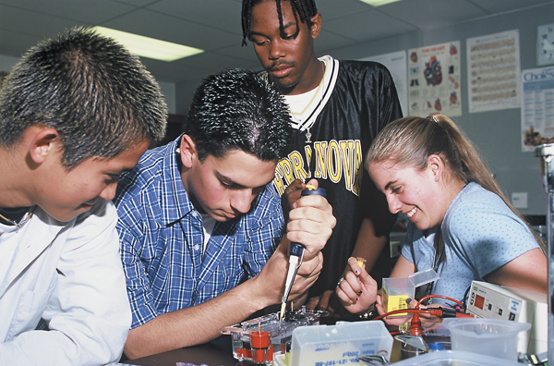
Finding Funds for Biotechnology Studies Grant Writing Workshop
Bio-Rad Biotechnology Explorer™ Program

Slide 2
Instructors - Bio-Rad Curriculum and Training Specialists
Sherri Andrews, Ph.D., Eastern US
sherri_andrews@bio-rad.com
Damon Tighe, Western US
damon_tighe@bio-rad.com
Leigh Brown, M.A., Central US
leigh_brown@bio-rad.com

Slide 3
Sources of funding
Awards
Scholarships
Grants

Slide 4
Workshop Outline
How to write a grant
How to design a program
How to search for funding

Slide 5
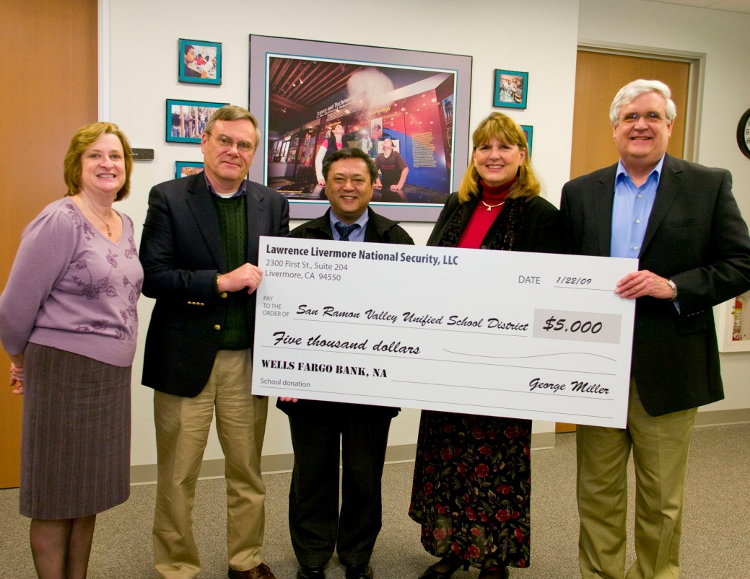
Workshop Goal
All participants leave ready to apply for a grant.
Workshop will focus on grants in the $500 - $5,000 range.

Slide 6
Getting Started
Grant Toolkit:
Sample Letter of Support
Sample Proposal
Sample Budget & Narrative

Slide 7
Proposal Process
Identify and contact team
Identify Need
Design Program
Find a funding source
Writing Proposal

Slide 8
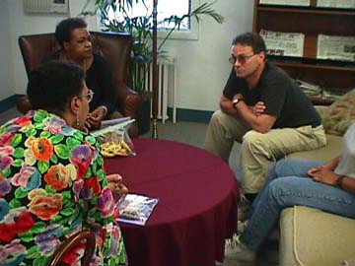
Putting your team together
Administrator
Counselor
Assessment coordinator
Community relations officer
Industry / community member
Key teachers
4 – 7 members is ideal, smaller grants should have smaller teams

Slide 9
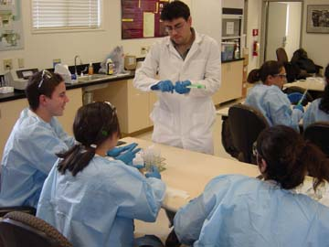
Identify Need
Relevance
Rigor
Relationships

Slide 10
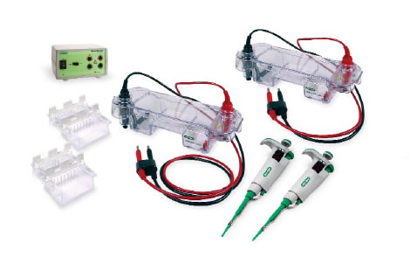
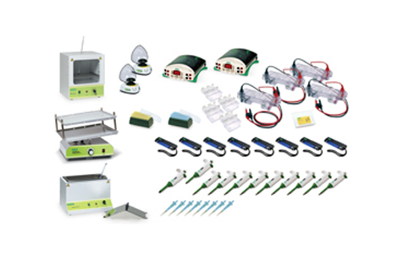
Designing Your Program (Vision)
Identifying what you need
Scaling model: “ Demo to Deluxe ”
Partnerships/collaboratives
Colleges & University (incl. CC)
Business & industry (incl. small business)
Service & Non-profit Organizations
Other schools / district
Parents & community

Slide 11
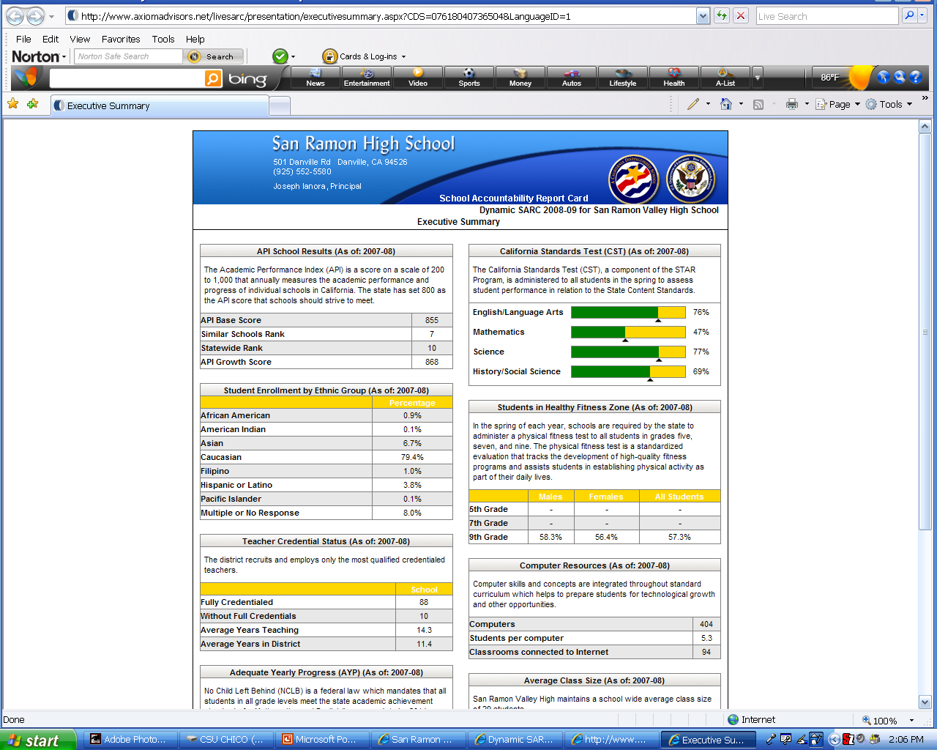
Writing A Proposal
GENERAL INFORMATION
Sources of Information
School Accountability Reports
District Reports
School Plan
WASC
National/State Assessments
Counselors, Public Affairs Officers,
Assessment Coordinators

Slide 12
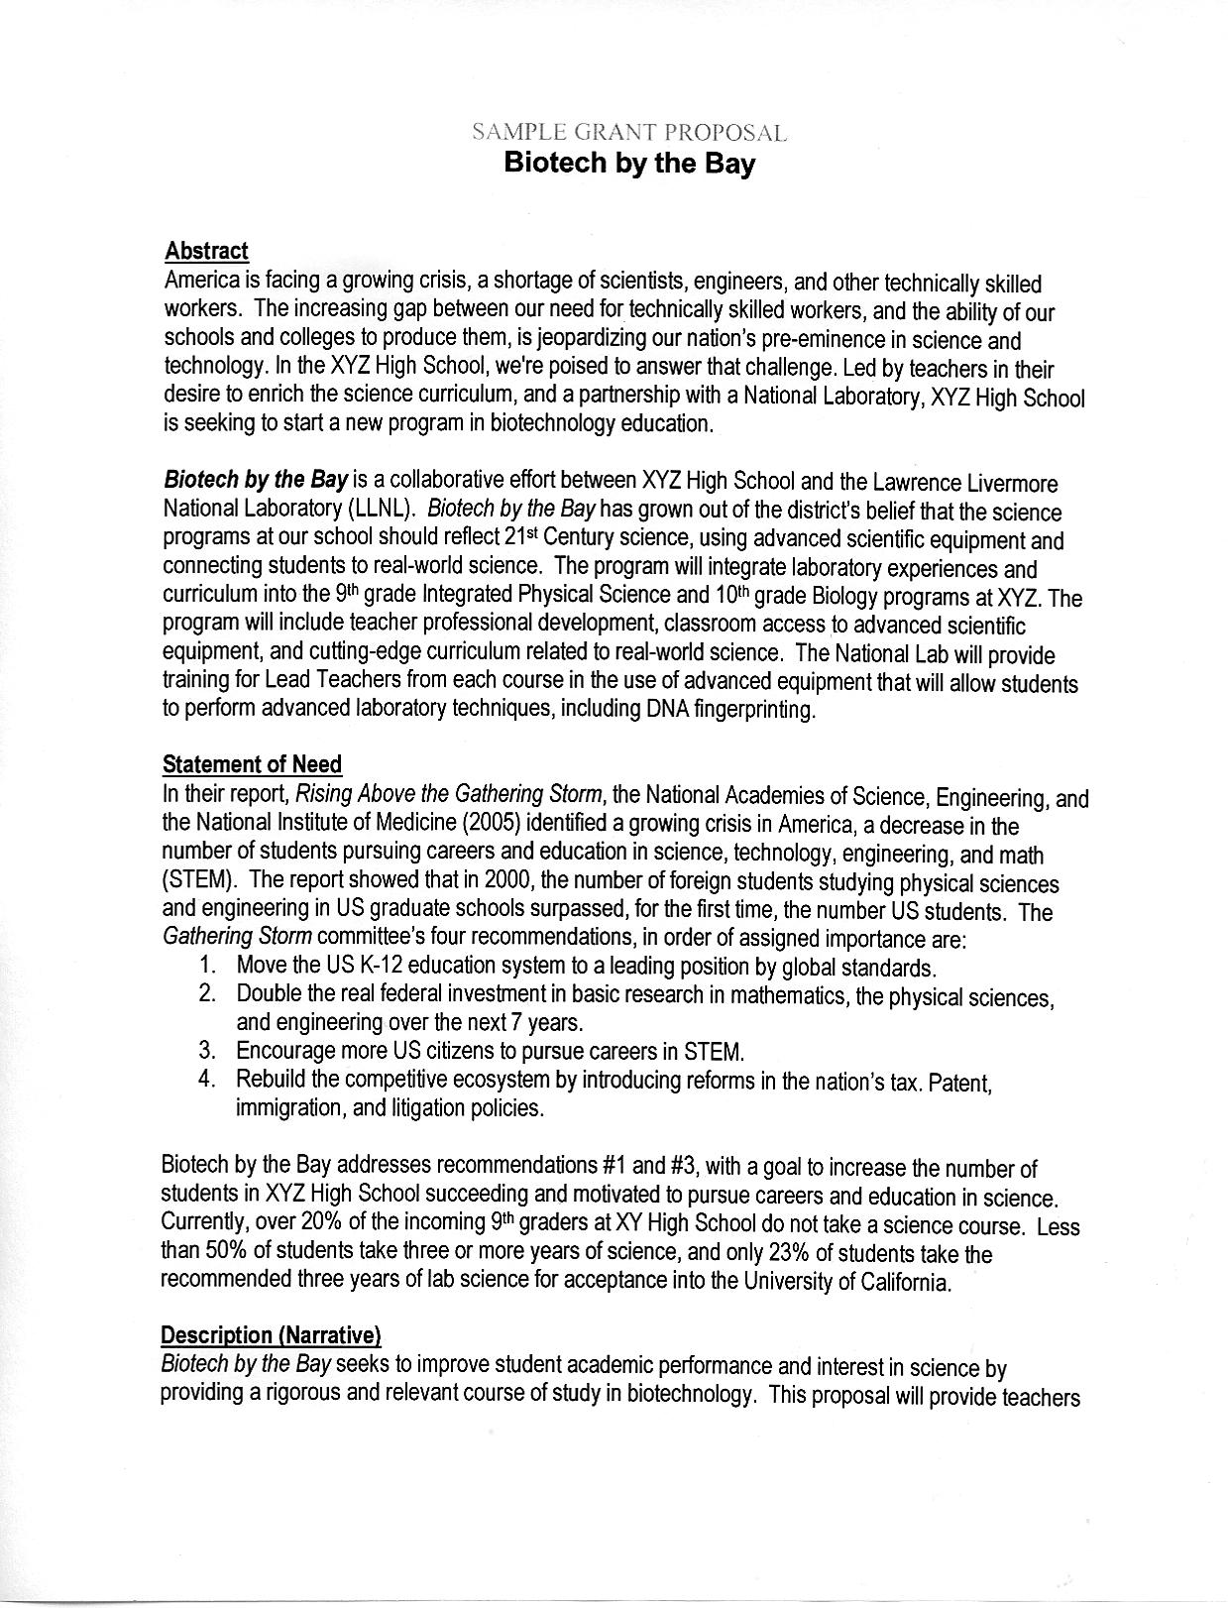
Writing A Proposal - cont’d
PROPOSAL OUTLINE - Sample
Need
Abstract
Description
Evaluation
Budget & Justification – Sample
Letter of support - Sample

Slide 13
Writing A Proposal - cont’d
ABSTRACT
Write after completing description
Provide complete, but generalized overview of program
Suitable for press-release

Slide 14
Writing A Proposal - cont’d
DESCRIPTION / NARRATIVE
What you will do
Who will do it
Timeline
Be explicit – particularly in regards to what students will be doing
Charts can help reduce wording, if space is a limitation
Sustainability

Slide 15
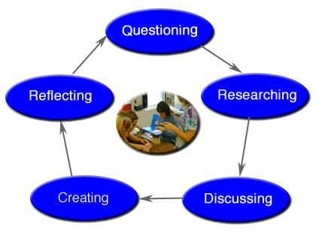
Writing A Proposal - cont’d
EVALUATION
How will you document whether the project met its goals?
Formative and summative evaluations
Web-based data management systems
Do not over-commit to a level of evaluation you cannot provide
Data should be used a part of a “cycle of inquiry” to provide for “continuous improvement”

Slide 16
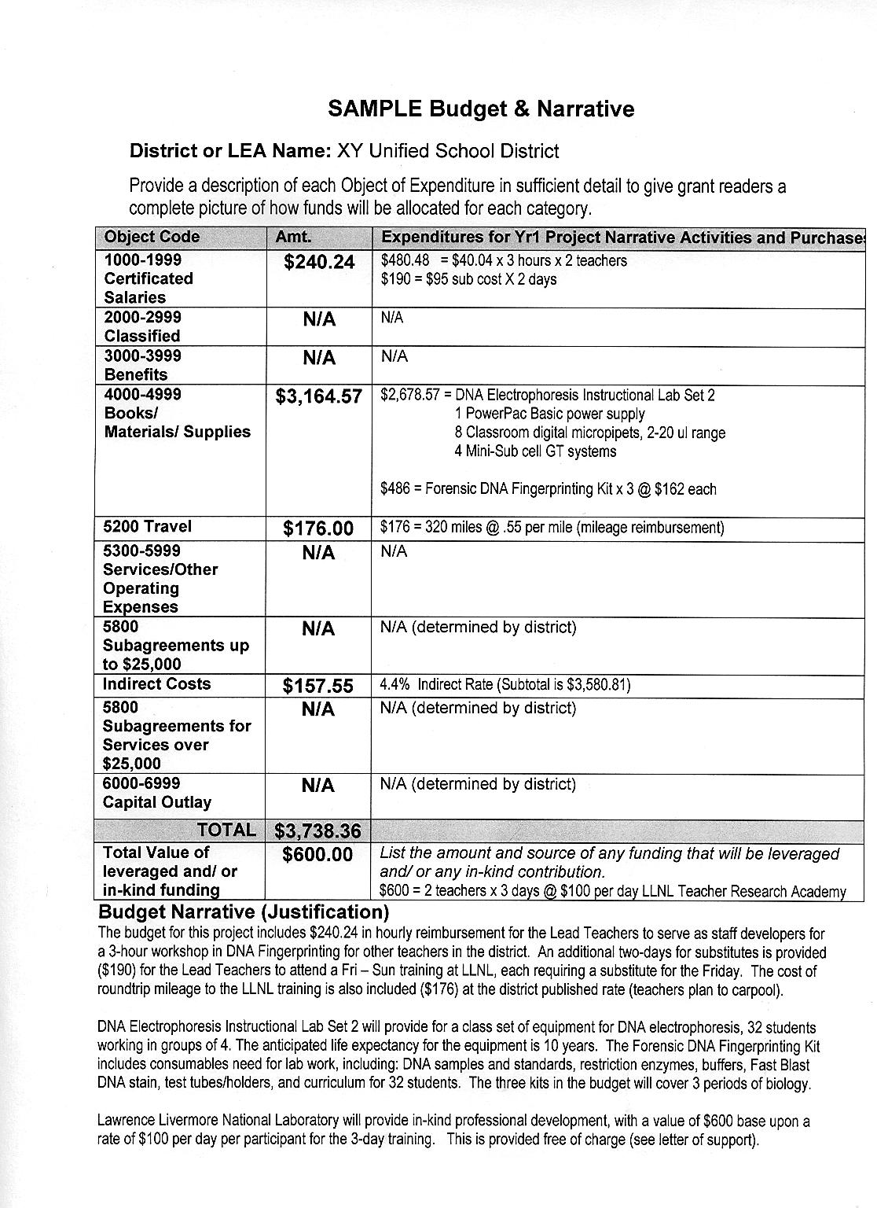
Writing A Proposal - cont’d
BUDGET / JUSTIFICATION
Consult with vendors for quotes
Don’t stress, most grants will allow 10 – 15% in changes
Use your school accountant or district business services for important info such as school codes, tax ID, indirect rates, etc.

Slide 17
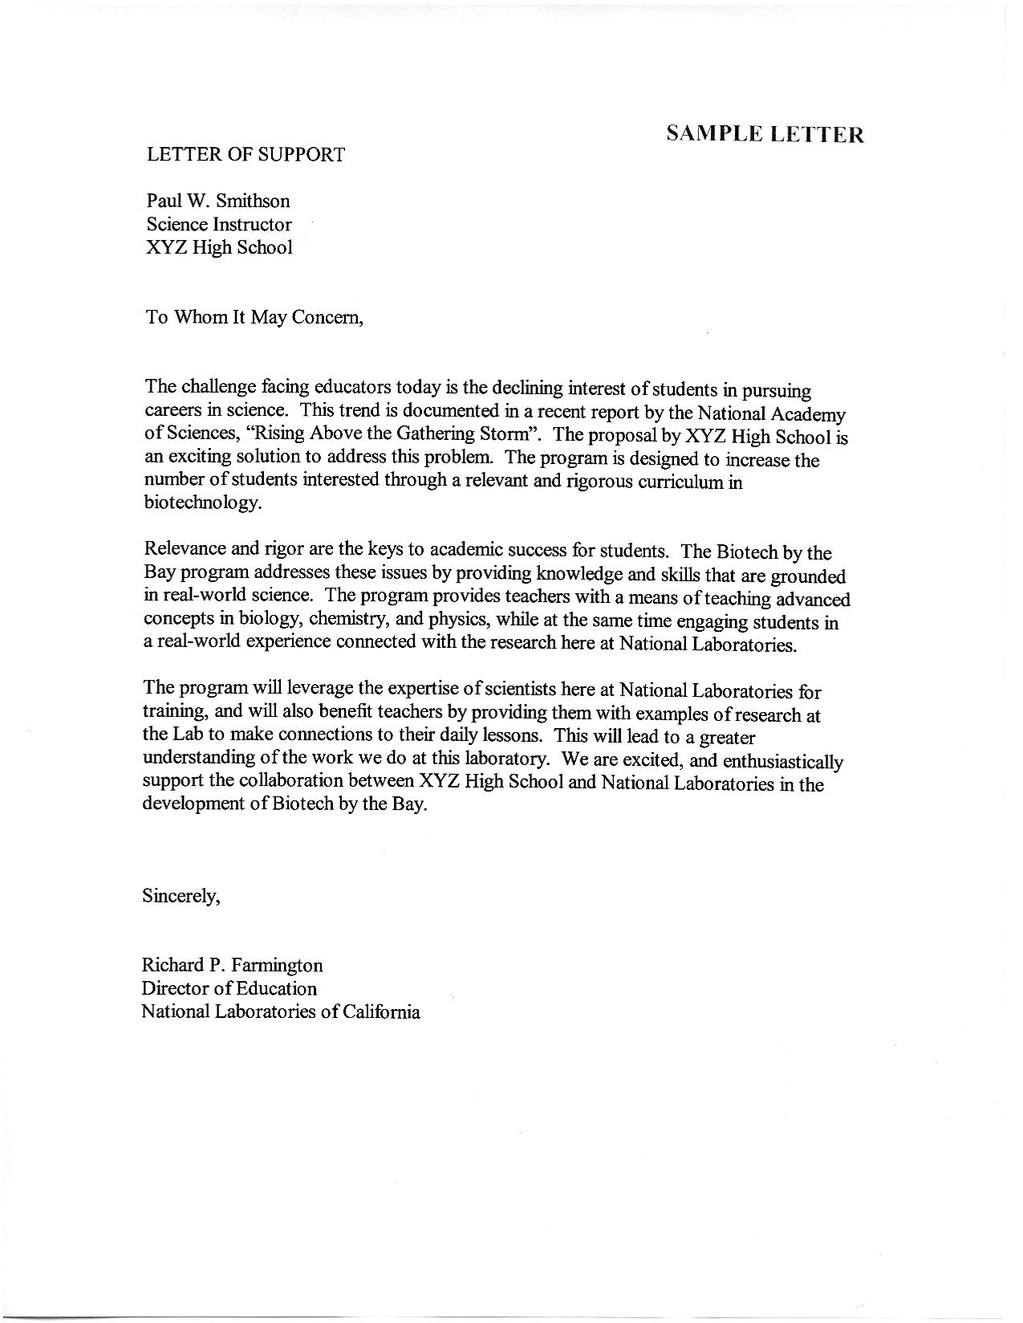
Writing A Proposal - cont’d
LETTER OF SUPPORT
Ask early (minimum 2-weeks) and always offer to provide a sample
Let them know if there are formatting requirements
Differentiate as to level of involvement:
Supporters vs. Partners

Slide 18
Writing A Proposal - cont’d
TIPS for a successful proposal
Follow format guidelines
Submit proposal on time
Stay focused, don’t overcommit
Stay within budget limits
Include in-kind contributions
Remember, only grants that are submitted will be funded !!!

Slide 19
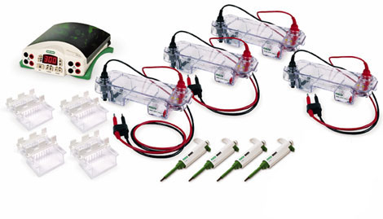
Design
Design your program with flexibility in mind
Plan for growth

Slide 20
Levels of Grants
State / National
Higher funding levels
Highly competitive / complex proposals
Higher level of accountability/evaluation
Local
Small / mini-grants ($200 - $5,000)
Short proposals 2-7 pages
Local area (local-focus grants)
Build upon local relationships & partners
Site-based, district, county, regional

Slide 21
Search Strategies
District Office – directors / coordinators
County Office –newsletters / web sites
Professional Journals / web sites
Online:
NSTA
State Science Teachers
County Office of Education
GOOGLE

Slide 22
Search Strategies – cont’d
Grants Alert
www.grantsalert.com/education.cfm
GrantWrangler
www.grantwrangler.com
Teachers Network
www.teachersnetwork.org/Grants/
WEB SEARCH (Google)
Key words: grants, education, foundation, science, __state, __city

Slide 23
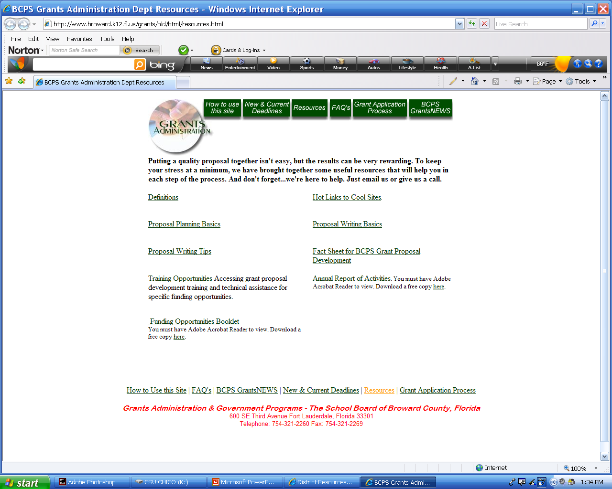

Slide 24
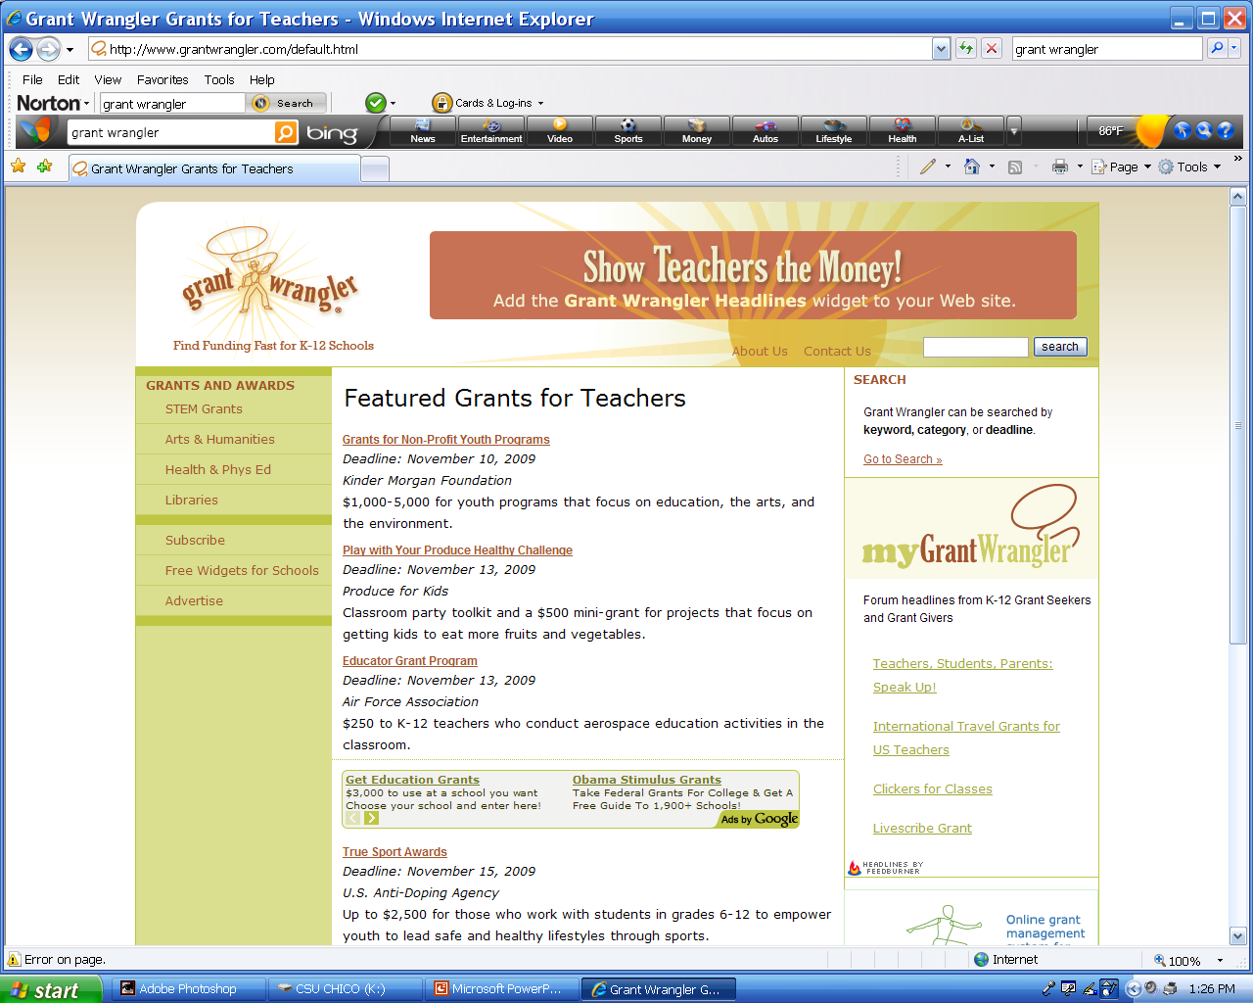

Slide 25
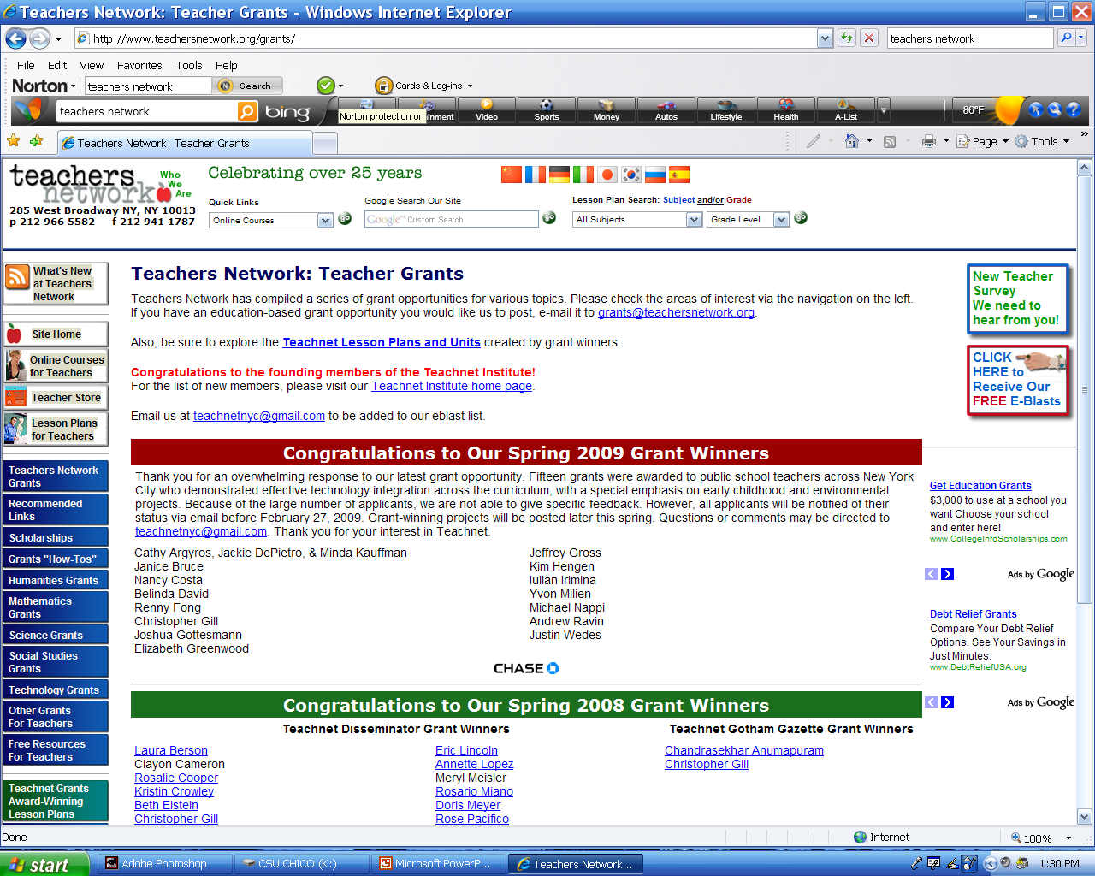

Slide 26
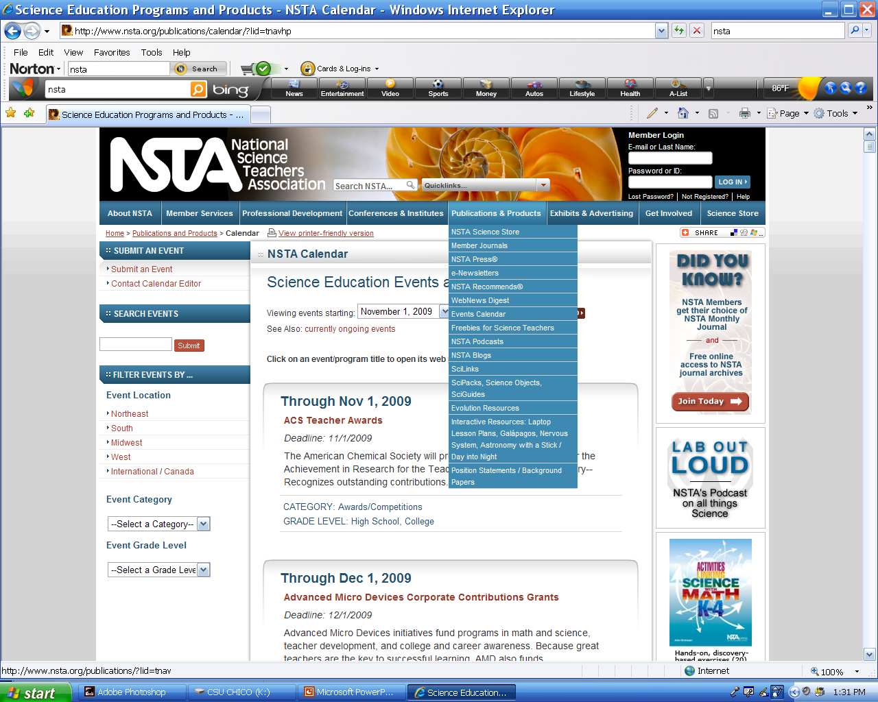

Slide 27
Get going !
African proverb
Every morning in Africa, a gazelle wakes up. It knows it must run faster than the fastest lion or it will be killed.
Every morning a lion wakes up. It knows it must run outrun the slowest gazelle or it will starve to death.
It doesn’t matter whether you are a lion or gazelle. When the sun comes up, you better start running

