Slide 1
From Grass to Gas: An Inquiry Based Study of Enzyme
Bio-Rad Biotechnology Explorer™ Biofuel Enzyme Kit

Slide 2
Instructors - Bio-Rad Curriculum and Training Specialists
Sherri Andrews, Ph.D., Eastern US
sherri_andrews@bio-rad.com
Damon Tighe, Western US
damon_tighe@bio-rad.com
Leigh Brown, M.A., Central US
leigh_brown@bio-rad.com

Slide 3
What are enzymes?
Molecules, usually proteins, that speed up the rate of a reaction by decreasing the activation energy required without themselves being altered or used up
Background - Enzymes
Enzyme Class | Example
Oxidoreductase (transfer of electrons) | Firefly Luciferase – oxidizes luciferin to produce oxyluciferin and light
Transferase (group-transfer reactions) | Hexokinase – transfers a phosphate group to glucose to make glucose-6-phosphate
Hydrolase (hydrolysis reactions) | Cellobiase – breaks down cellobiose
Lyase (double bond reactions) | Histidine decarboxylase – generates histimine from histidine
Isomerase (transfers to create a new isomers) | Glucose-6-Phosphate isomerase – converts G-6-P to fructose-6-phosphate
Ligase (forms covalent bonds) | DNA Ligase – covalently bonds two pieces of DNA

Slide 4
How do enzymes work?
Background - Enzymes
Enzyme
Substrate (S) Product (P)
S*
ENERGY
S*_{enz}
E_{act}
E_{act}
S
P
REACTION COORDINATE

Slide 5
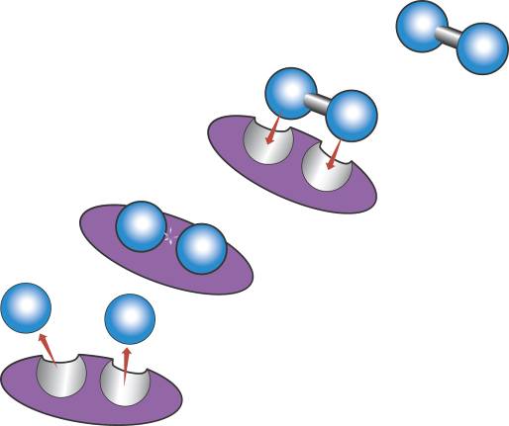
How do enzymes work?
Background - Enzymes
Substrate free in solution
Substrate binds to a specific cleft or groove in the enzyme
Activation energy barrier is overcome and reaction occurs
Product is released and enzyme is free to catalyze another reaction

Slide 6
What are biofuels?
Background - Biofuels
Fuels that are produced from a biological source
Oil – biofuel, but very long production cycle (millions of years)
Biodiesel
Ethanol from starches/sugars
Cellulosic ethanol
Butanol
Short cycle Biofuels

Slide 7
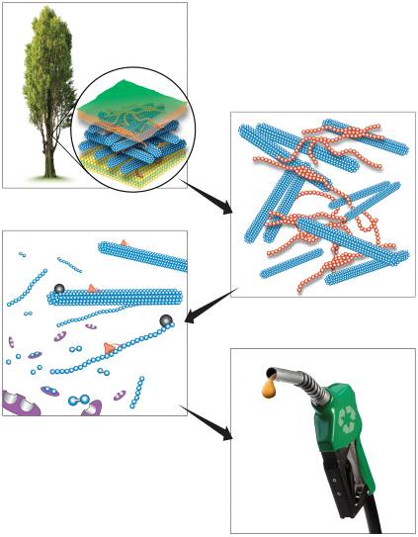
Cellulosic ethanol production
Background - Biofuels
A
B
C
D

Slide 8
Cellulose breakdown
Background – Biofuels production
Glucose
1. Heat, acid, ammonia or other treatment
Endocellulases
Exocellulases
2. Enzyme mixture added
Cellobiase

Slide 9
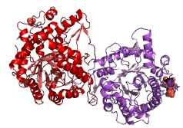
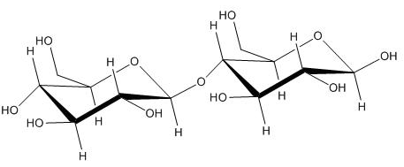
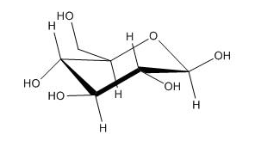
Cellobiose breakdown- a closer look
Background - cellobiose
4
+
1
6
4
5
2
1
3
Cellobiose + H₂O 2 Glucose

Slide 10
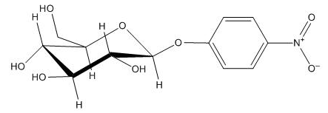
Protocol Highlights:
Using a colorimetric substrate to track reaction rate
Background – cellobiase detection system
• Cellobiose and glucose are colorless when dissolved
cellobiose
• modified substrate colorimetric detection
p-nitrophenyl glucopyranoside

Slide 11
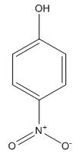
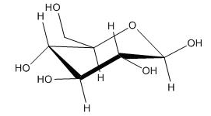
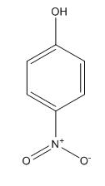
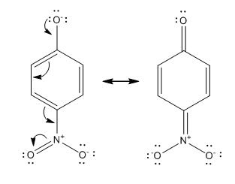
Cellobiase breakdown of p-nitrophenyl glucopyranoside
Background – cellobiase detection system
+
p-nitrophenyl glucopyranoside + H₂O glucose + p-nitrophenol
Basic conditions
Clear
Yellow

Slide 12
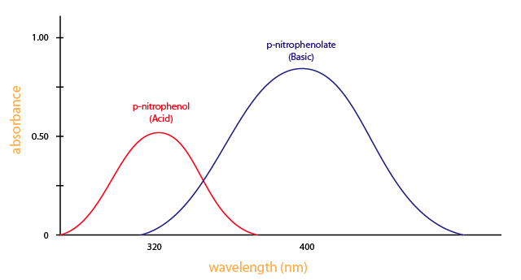
How can this enzymatic reaction be easily quantified?
Background – cellobiase detection system
Basic solution (STOP SOLUTION):
- will develop color of any p-nitrophenol present
- will stop the reaction
Qualitative – Visually Compare vs p-nitrophenol Standards
Quantitative- read absorbance at 410 nm using a spectrophotometer or microplate reader.

Slide 13
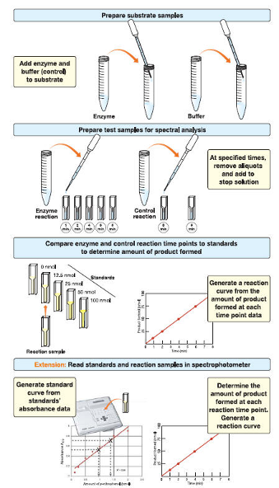
Biofuel Enzyme kit Activity 1

Slide 14
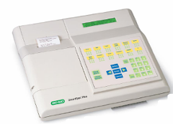
Biofuel Enzyme kit Activity 1
SmartSpec™ Plus
Photodiode Array UV-VIS Spectrometer
Measures
  Absorbance , %T
Specifications
  Range: 200-800 nm
  Optical Resolution: ± 2 nm
  Light Source: Xenon Flash Lamp
  Power: 120 VAC, 60 Hz
Standalone Research Grade Instrument
170-2525EDU

Slide 15
Biofuel Enzyme Kit
Procedure Overview
Biofuel Enzyme kit Activities
Activities:
Reaction Rate & Std curve
Effect of Temperature
Effect of pH
Effect of Enzyme Concentration
Effect of Substrate Concentration
Bio-prospecting for Celliobiase
Collaborative approach:
  Each student group does activity 1
  Student groups do one activity each from 2-5
  Groups share data
  All groups do activity 6 and share data

Slide 16
Biofuel Enzyme kit Activities
Standard | Amount of p-nitrophenol (nmol) | Absorbance 410 nm
S1 | 0 | 0
S2 | 12.5 | 0.2
S3 | 25 | 0.4
S4 | 50 | 0.8
S5 | 100 | 1.6
Std curve / Std Reaction Rate
Effect of Temperature
Effect of pH
Effect of Enzyme Concentration
Effect of Substrate Concentration
Bio-prospecting for Celliobiase

Slide 17
Biofuel Enzyme kit Activities
Std curve / Std Reaction Rate
Effect of Temperature
Effect of pH
Effect of Enzyme Concentration
Effect of Substrate Concentration
Bio-prospecting for Celliobiase

Slide 18
Biofuel Enzyme kit Activities
Std curve / Std Reaction Rate
Effect of Temperature
Effect of pH
Effect of Enzyme Concentration
Effect of Substrate Concentration
Bio-prospecting for Celliobiase
Amount of p-nitrophenol produced (nmol)
Initial reaction rate =
Time (min)
Initial reaction rate =
50 nmol - 0 nmol
= 12.5 nmol/min
4 min - 0 min

Slide 19
Biofuel Enzyme kit Activities
Std curve / Std Reaction Rate
Effect of Temperature
Effect of pH
Effect of Enzyme Concentration
Effect of Substrate Concentration
Bio-prospecting for Celliobiase

Slide 20
Biofuel Enzyme kit Activities
Amount of p-nitrophenol produced (nmol)
Initial reaction rate =
Std curve / Std Reaction Rate
Effect of Temperature
Effect of pH
Effect of Enzyme Concentration
Effect of Substrate Concentration
Bio-prospecting for Celliobiase
Time (min)
This is the amount of p-nitrophenol produced in 2 minutes

Slide 21
Biofuel Enzyme kit Activities
Std curve / Std Reaction Rate
Effect of Temperature
Effect of pH
Effect of Enzyme Concentration
Effect of Substrate Concentration
Bio-prospecting for Celliobiase
High enzyme concentration
Low enzyme concentration
Amount of p-nitrophenol formed (nmol)
Time (minutes)
1. The initial reaction rate is faster when there is a higher enzyme concentration
2. Given enough time, the same amount of product will be formed for both the high and low enzyme concentration reactions

Slide 22
Biofuel Enzyme kit Activities
1.5 mM substrate [High]
Std curve / Std Reaction Rate
Effect of Temperature
Effect of pH
Effect of Enzyme Concentration
Effect of Substrate Concentration
Bio-prospecting for Celliobiase
Amount of p-nitrophenol formed (nmol)
0.25 mM substrate [Low]
Time (minutes)
1. Effect of substrate concentration on the initial rate
2. Final amount of product formed with varying substrate concentrations

Slide 23
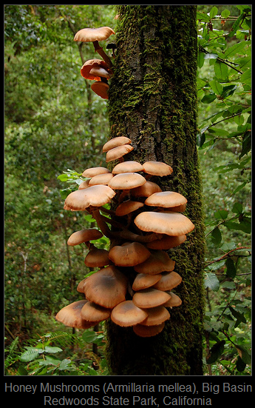
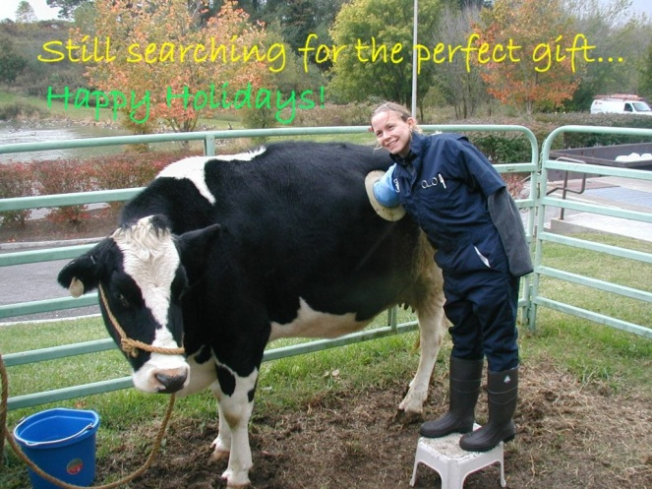
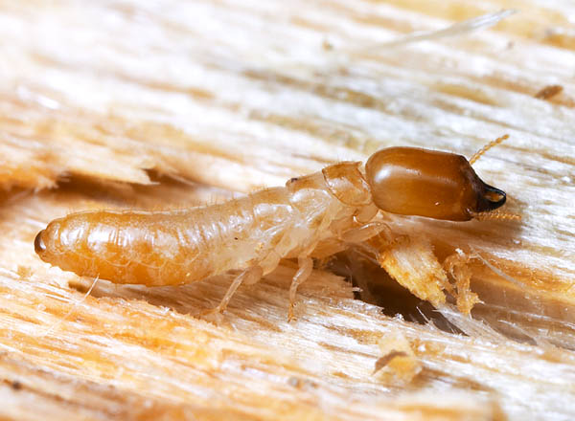
Biofuel Enzyme kit Activities
Where can we find things that break down cellulose?
Std curve / Std Reaction Rate
Effect of Temperature
Effect of pH
Effect of Enzyme Concentration
Effect of Substrate Concentration
Bio-prospecting for Celliobiase

Slide 24
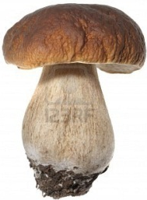
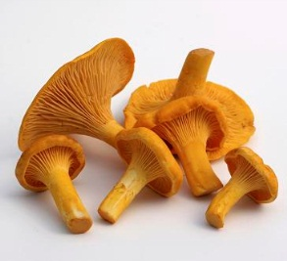
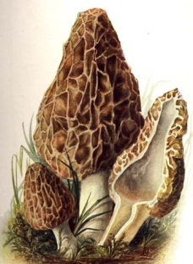
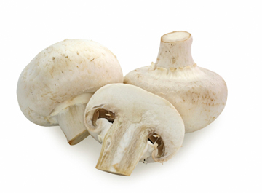
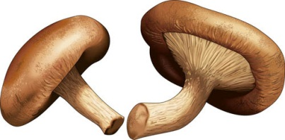
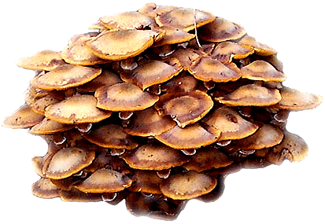
Biofuel Enzyme kit Activity 6
Mushrooms – Ecological niche for food
Mycorrhizal –associated with plant roots
  Porcini
  Chanterelle
Saprotrophic – decomposers
  Shiitake
  Morel
  Button
Parasitic – attacks plants
  Honey Mushroom
Std curve / Std Reaction Rate
Effect of Temperature
Effect of pH
Effect of Enzyme Concentration
Effect of Substrate Concentration
Bio-prospecting for Celliobiase

Slide 25
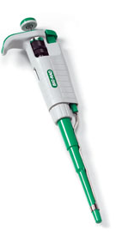
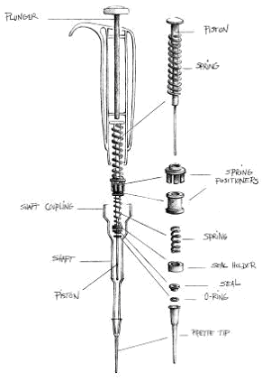
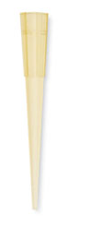
Biofuel Enzyme kit Activities
Plunger
Two stops
Using a Micropipette
1st – defines volume
2nd – ejects volume
Tip Ejector

Slide 26
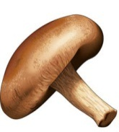

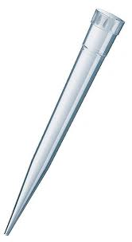
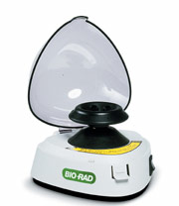
Biofuel Enzyme kit Activities
Activity 6
Protocol
Pick a mushroom
Add ~ 0.25g of mushroom to microcentrifuge tube
crush with blunted pipette tip
Add 1,000 µl extraction buffer and continue crushing
Spin down extract in microcentrifuge to separate mushroom particles from liquid fraction or filter and put liquid fraction in new centrifuge tube (~250ul)

Slide 27
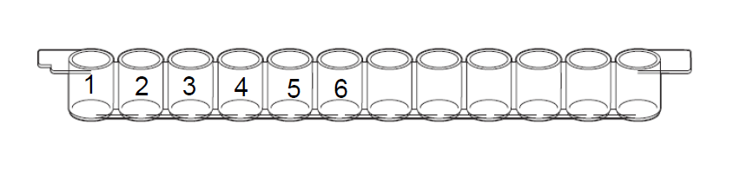
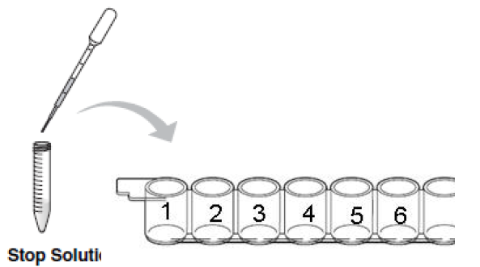

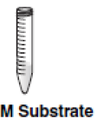
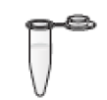
Biofuel Enzyme kit Activities
6. Label microplate wells 1-6
Activity 6
Protocol
7. Add 100ul of Stop solution to wells 1-6
8. Label a 2ml centrifuge tube with your initials and add 1.5ml of substrate

Slide 28
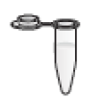
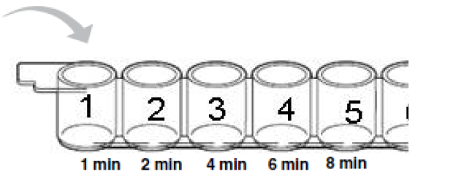
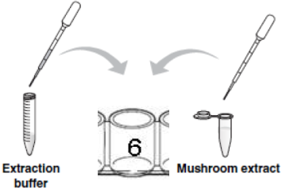
Biofuel Enzyme kit Activities
9. Add 125ul of mushroom extract to substrate and start your clock.
Activity 6
Protocol
10. At the appropriate times remove 100ul from your reaction and add it to the corresponding well of your microplate. Make sure to mix.
11. To make an appropriate blank, add 92ul of extraction buffer to well 6 and 8 ul of mushroom extract.

Slide 29
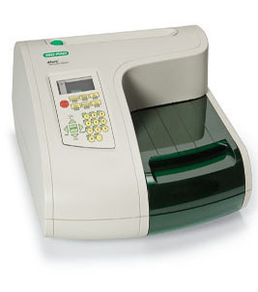
Biofuel Enzyme kit Activities
Read samples on iMARK Platereader
Activity 6
Protocol
Reads 400-750nm
Reads 96 samples in under 10 seconds
Onboard printer, but best to connect to sofoware for easy data manipulation
Can do kinetics, plate shaking, etc

Slide 30
Biofuel Enzyme kit Activity 6
Standard | Amount of p-nitrophenol (nmol) | Absorbance 410 nm
S1 | 0 | 0
S2 | 12.5 | 0.2
S3 | 25 | 0.4
S4 | 50 | 0.8
S5 | 100 | 1.6
Std curve / Std Reaction Rate
Effect of Temperature
Effect of pH
Effect of Enzyme Concentration
Effect of Substrate Concentration
Bio-prospecting for Celliobiase
Y = mx + b, solve for X
M = slope
b = y-intercept (can use 0 for ease)

Slide 31
Biofuel Enzyme kit Activity 6
Derive p-nitrophenol concentrations from Abs data
Std curve / Std Reaction Rate
Effect of Temperature
Effect of pH
Effect of Enzyme Concentration
Effect of Substrate Concentration
Bio-prospecting for Celliobiase
X = (y-b)/m
Time | Absorbance 410 nm | Amount of p-nitrophenol (nmol)
#1 – 1 min
#2 – 2 min
#3 – 4 min
#4 – 6 min
#5 – 8 min
#6 - Blank

Slide 32
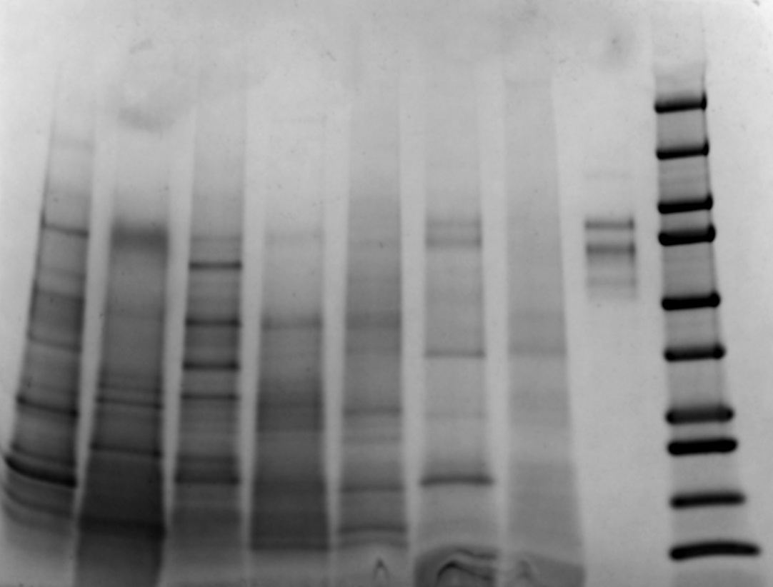
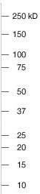
Further Studies (not in kit)
SDS PAGE Gel of mushroom extracts
Biofuel Enzyme kit – Further Studies
Aspergillus niger
Chicken of the Woods
Lion’s Mane
Kaleidoscope marker
King Oyster
Chanterelle
shiitake
Beech
Oyster
Aspergillus niger has 3 cellobiases at 88, 80, 71KD in the literature.
Chanterelle is mycorrhizal, has no activity when assayed and no bands in cellobiase range
Mushroom samples above were dried cubes

Slide 33
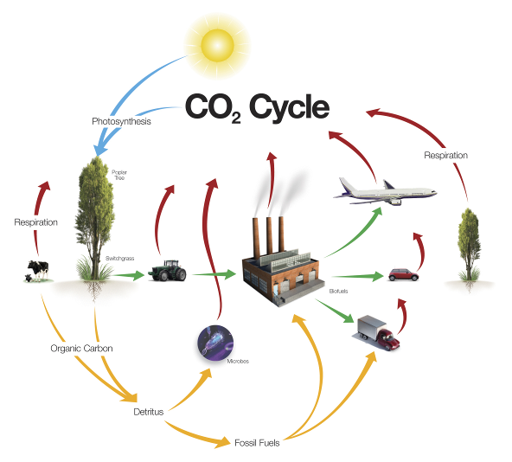
Cross curriculum approach
Social Studies – debate biofuels
Environmental Science – effects of biofuel production /global warming
Environmental Science – do the bio-prospecting
History – history of oil and other fuels
Engineering – research paper on how biofuels fit with oil infrastructure

