Slide 1


Slide 2
ELISA Immuno Explorer™ Kit
Instructors:
Stan Hitomi
Coordinator – Math and Science
San Ramon Valley Unified School District
Danville, CA
Kirk Brown
Lead Instructor, Edward Teller Education Center
Science Chair, Tracy High School
and Delta College, Tracy, CA
Sherri Andrews, Ph.D.
North Carolina School of the Arts
Winston-Salem, NC

Slide 3
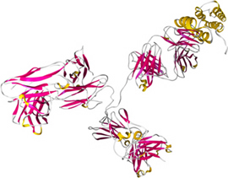
ELISA
Enzyme-Linked
Immunosorbant
Assay
Mammalian immune system
Antibody specificity
Biology’s “magic bullet”
Evolved over millions of years
Harness nature’s tool kit
Imagine the applications!

Slide 4

Links to the Real World
HIV, Mad Cow, SARS
Biodefense
Cancer treatment
Drug and steroid testing
Pregnancy / Reproduction
GMO

Slide 5
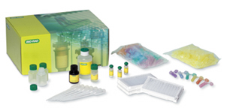
ELISA Immuno Explorer Kit Features
Lab completed in a 45 min period
Supplies for 48 students (12 workstations)
Comprehensive and flexible curriculum
Compelling real-world links
Cost effective
Classroom Safe
Striking results

Slide 6
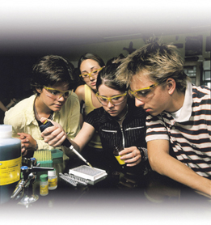
What Can You Teach With The ELISA Kit?
Hands-on Immunology
One lesson integrates multiple standards
  Health sciences
  Immunology
  Immune response – antibody/antigen interactions
  Disease – infection, detection, transmission
  Biowarfare – defense against acts of aggression
Links to research, medicine, and consumer products
Modern way to teach classic and contemporary science
Teach more with less!

Slide 7
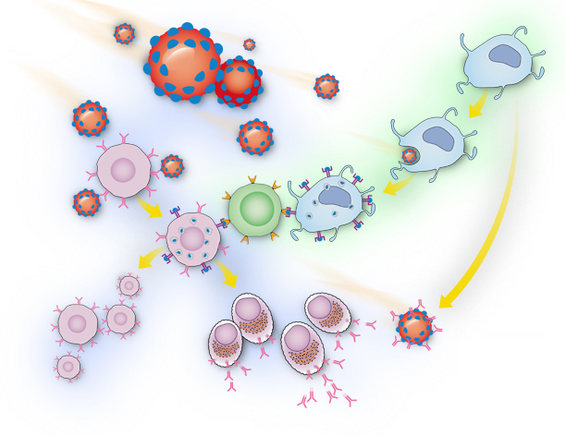
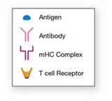
Immune Response
C. Macrophage
A. Pathogen
D. Macrophage
B. B cells
F. T cell
E. Macrophage
G. B cell
J. Antibodies attach to pathogen
H. Memory B cells
I. Plasma cells

Slide 8
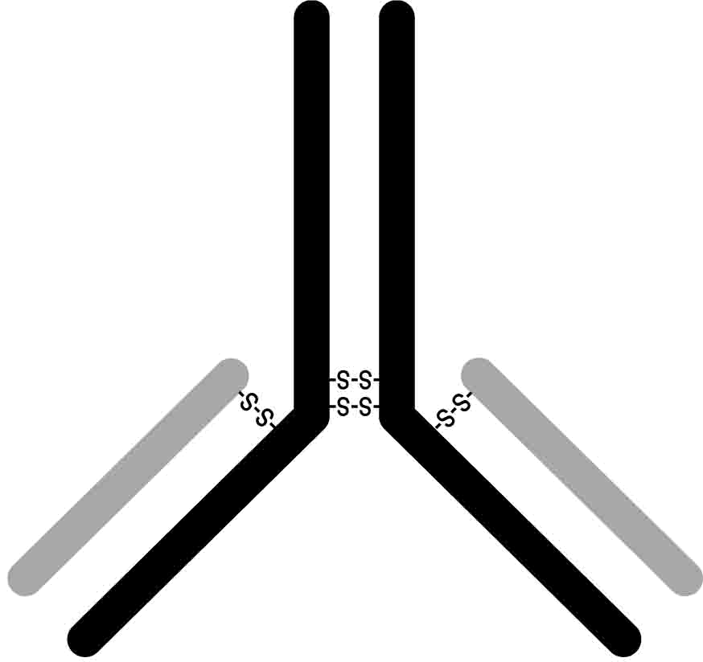
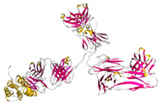

ELISA Antibody Structure
Heavy chain
Disulfide bonds
Light chain

Slide 9
ELISA ANIMATION

Slide 10
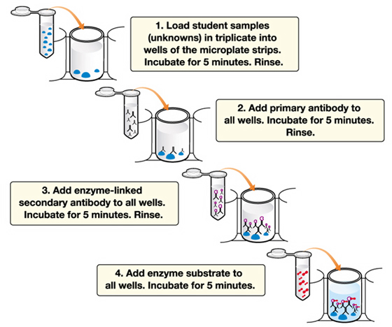
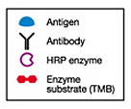
ELISA Enzyme-Linked
Immunosorbant
Assay
Notes:
Review activity steps

Slide 11
ELISA Kit Workstation Inventory
Reagents:
Yellow tubes Test samples 2
Violet tube (+) Positive control 1
Blue tube (-) Negative control 1
Green tube (PA) Primary antibody 1
Orange tube (SA) Secondary antibody 1
Lab Equipment and Supplies:
Microplate strips, pipettor, pipette tips,
transfer pipette, wash buffer, paper towels,
marking pen
Notes:
Discuss materials at each workstation

Slide 12
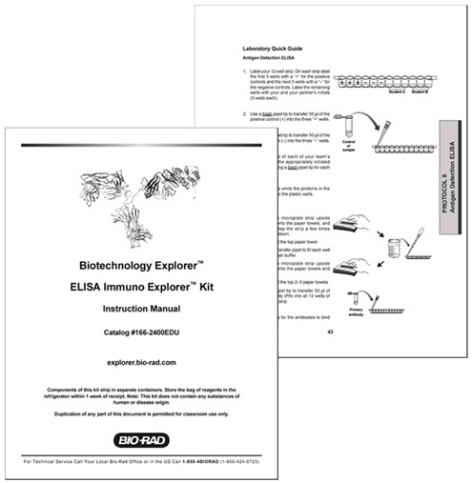
ELISA Kit Quick Guide
Notes:
Instruct participants to follow Quick Guide procedure at their own pace.

Slide 13
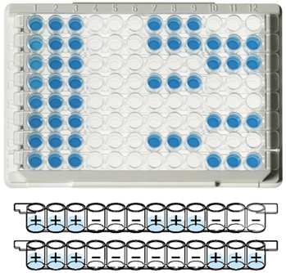
ELISA Kit Results
Notes:
Repeat FLASH animation to solidify what they just did.

Slide 14
What Are The Reagents?
And
What Function Do They Perform?
PBS: Phosphate buffered saline – provides stable buffered environment to maintain antibody structure
Tween 20: Nonionic detergent – removes non-specifically bound proteins to reduce background and blocks protein binding sites on the polystyrene
Microplates: Polystyrene – proteins absorb (bind) by hydrophobic bonds to the polystyrene

Slide 15
What Are The Reagents?
And
What Function Do They Perform?
Antigen: Chicken gamma globulin
Primary antibody: Polyclonal anti-chicken antibody made by rabbits
Secondary antibody: Polyclonal anti-rabbit antibody made by goats linked (conjugated) to horseradish peroxidase (HRP)
Enzyme substrate: 3,3’,5,5’ – tetramethylbenzidine (TMB) – a colorless solution that when oxidized by HRP turns blue

Slide 16
ELISA Kit Protocol Issues
Controls:
Protocols I and II
  Positive control = antigen
  Negative control = PBS
Protocol III
  Positive control = primary antibody
  Negative control = wash buffer
Triplicate samples: controls against cross contamination (2 out of 3 ain’t bad)
Washing: eliminates non-specific binding and reduces background

Slide 17

Ways The ELISA Kit Can Be Used
Protocol | Type of ELISA | Real-World Application
I | Tracking outbreaks of disease | HIV, SARS, smallpox & anthrax
II | Detecting antigens | Pregnancy, drugs, GMO, BSE (and all the above)
III | Detecting antibodies in serum | HIV, Lyme disease, smallpox and West Nile virus

Slide 18
Protocol I: Tracking Disease Outbreaks
Real-World Application - HIV Transmission & Detection
Step 1 - Share ‘body fluid’ samples to simulate disease transmission
Step 2 - ELISA to detect infection
Tube Description | Actual Tube Contents | Simulated Tube Contents
Student samples | Antigen or PBS | Sample derived from patient’s blood
Primary antibody | Primary antibody | Antibody against HIV from mice
Secondary antibody | Secondary antibody | HRP-linked antibody against mouse antibodies
Positive control | Antigen | Heat-inactivated HIV virus
Negative control | PBS | HIV negative human serum
Results – Infection of about 50% of students

Slide 19
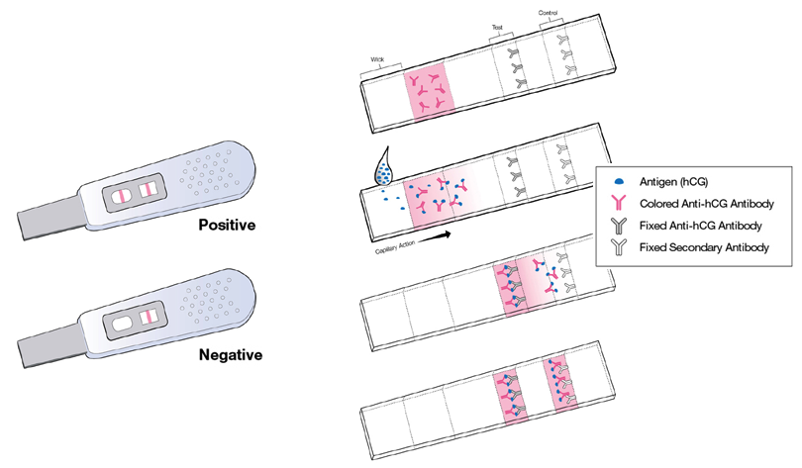
Protocol II: Antigen Detection ELISA
Real-World Application – Pregnancy Test
Protocol - ELISA on simulated urine samples
Tube Description | Actual Tube Contents | Simulated Tube Contents
Student samples | Antigen or PBS | Patient’s urine sample
Primary antibody | Primary antibody | Antibody against hCG hormone from mice
Secondary antibody | Secondary antibody | HRP-linked antibody against mouse antibodies
Positive control | Antigen | Purified hCG hormone
Negative control | PBS | Urine from woman that is not pregnant

Slide 20
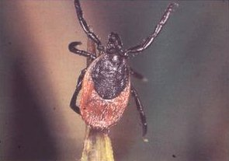
Protocol III: ELISA Antibody Test
Real-World Application – Lyme Disease
Protocol - ELISA to detect exposure to a disease
Do you have antibodies to the disease?
Tube Description | Actual Tube Contents | Simulated Tube Contents
Purified antigen | Antigen | B. Bergoferi purified proteins
Student samples | Primary antibody or wash buffer | Patient’s serum samples
Secondary antibody | Secondary antibody | HRP-linked antibody against B. bergoferi
Positive control | Primary antibody | Serum from patients with Lyme disease
Negative control | Wash buffer | Serum negative for Lyme disease

Slide 21
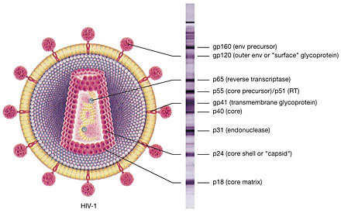
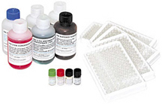
Real-world Applications of Antibodies
Uses
  – Disease diagnosis
  – Basic Research
  – Immunotherapy
Applications
  – Dipstick tests/ELISA
  – Immunostaining
  – Western blotting
Bio-Rad’s HIV-2
ELISA Kit
Bio-Rad’s HIV
Western Blot Kit

Slide 22
Example: Pregnancy Test

