Slide 1
Bumblebee Barcoding
Activity for use with the Mammals, Insects, and Fungi DNA Barcoding Kit
BIO-RAD is a trademark of Bio-Rad Laboratories, Inc. All trademarks used herein are the property of their respective owner.
© 2022 Bio-Rad Laboratories, Inc.

Slide 2

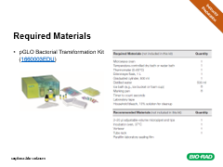
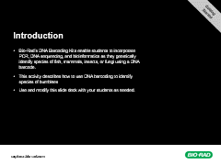
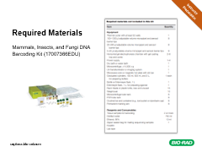
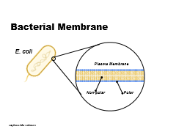
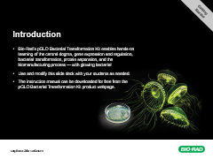
Contents
Getting
Started
Getting Started
Instructor Preparation
Activity Slides
Introduction
Additional Resources
Required Materials

Slide 3
Introduction
Getting
Started
Bio-Rad’s DNA Barcoding Kits enable students to incorporate PCR, DNA sequencing, and bioinformatics as they genetically identify species of fish, mammals, insects, or fungi using a DNA barcode.
This activity describes how to use DNA barcoding to identify species of bumblees
Use and modify this slide deck with your students as needed.

Slide 4
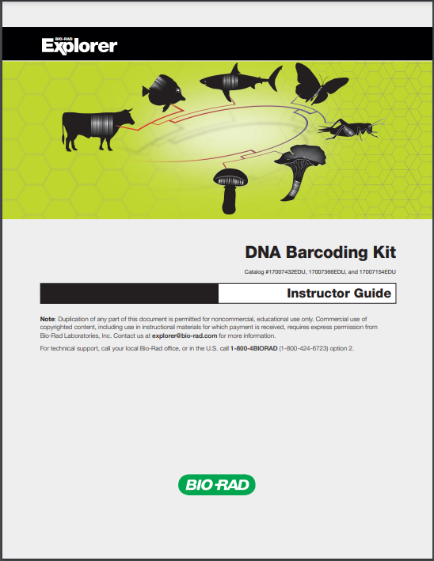
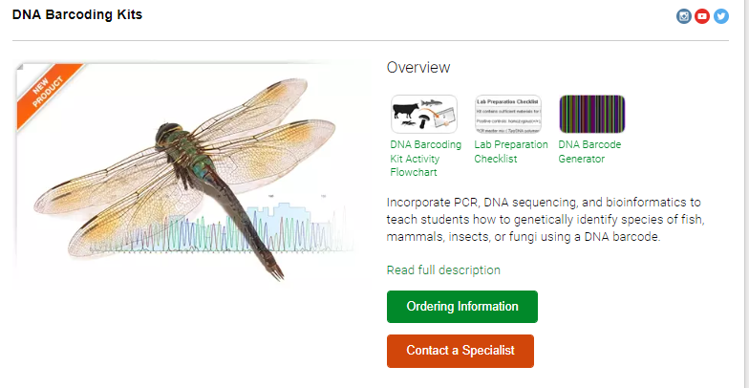
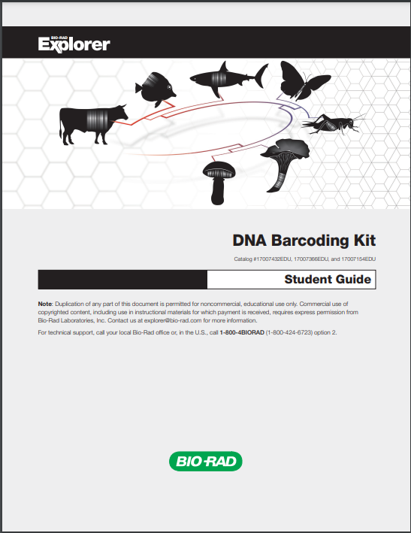
Additional Resources
Getting
Started
Visit bio-rad.com/barcoding for more background information about DNA Barcoding Kits and to download instruction manuals.
DNA Barcoding Kits

Slide 5
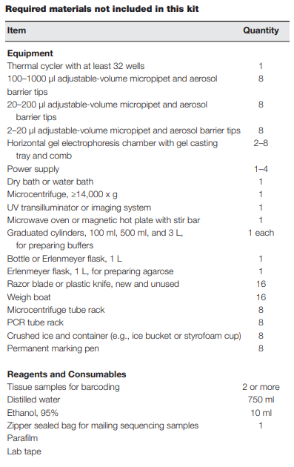
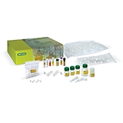
Required Materials
Instructor Preparation
Mammals, Insects, and Fungi DNA Barcoding Kit (17007366EDU)

Slide 6
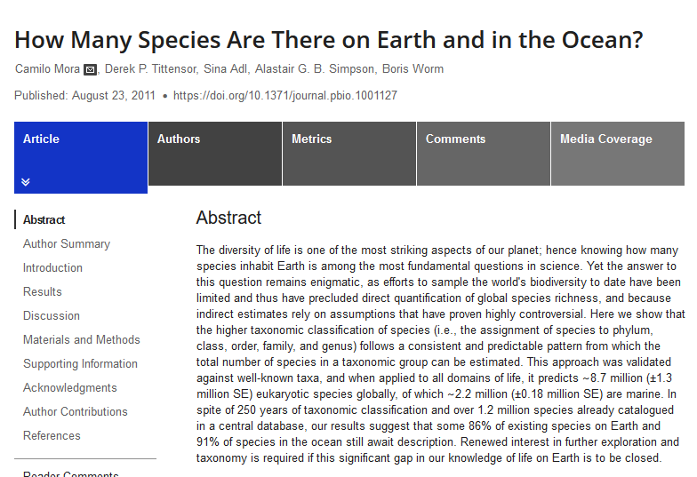
“Seeing” species is key to conservation and understanding ecosystems
>86% species undescribed
Notes:
To understand the biological world, we often must start with the simplest thing: naming things so that we can organize them.
Most of the biological world, in terms of species, is still un-named and thus unseen, which makes it difficult for us to understand things like ecosystems in detail.

Slide 7
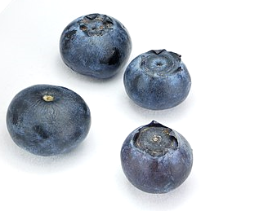
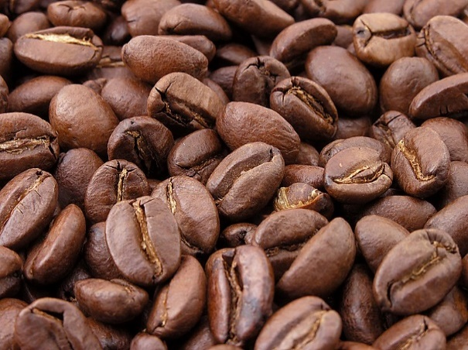
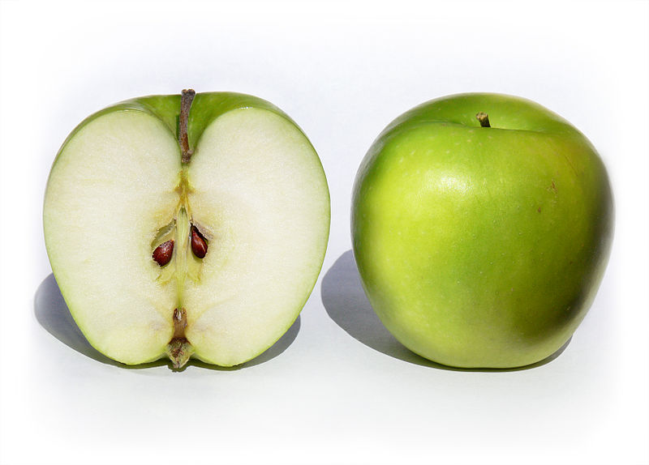
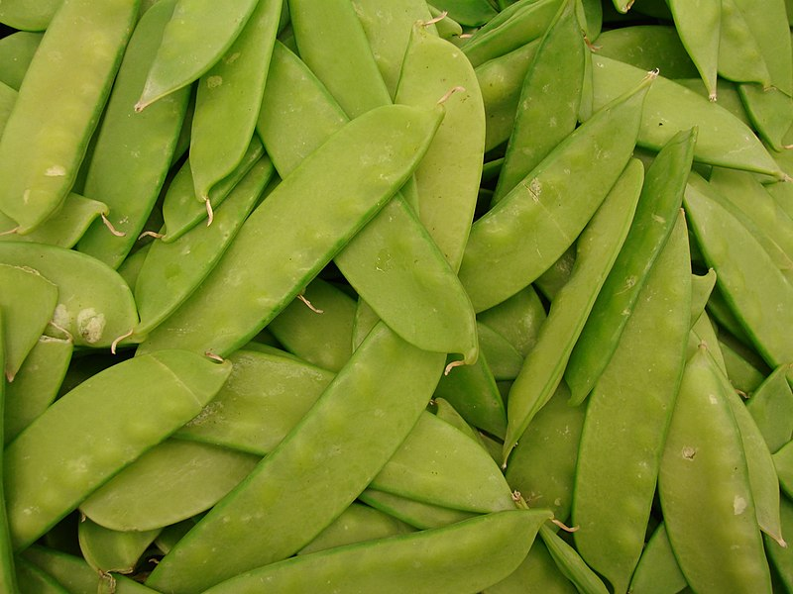
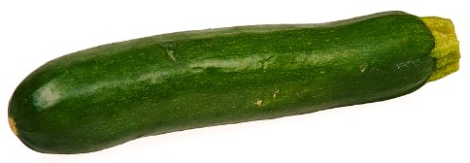
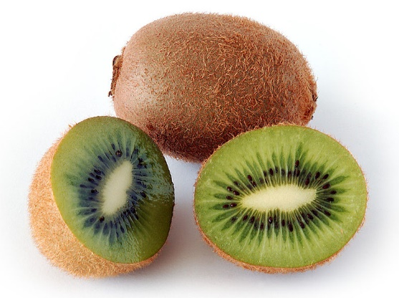
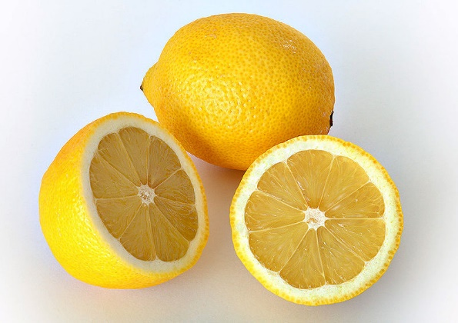
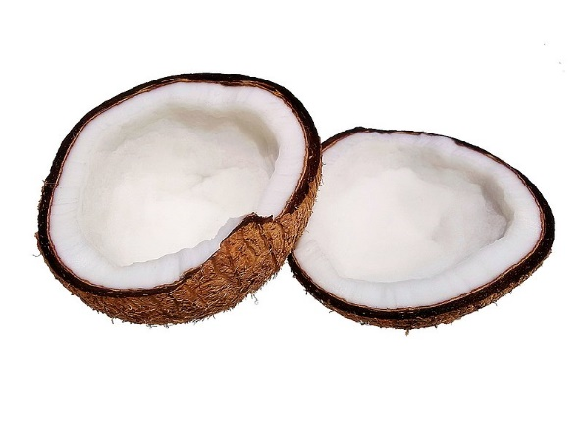
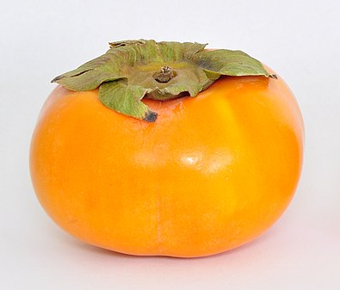
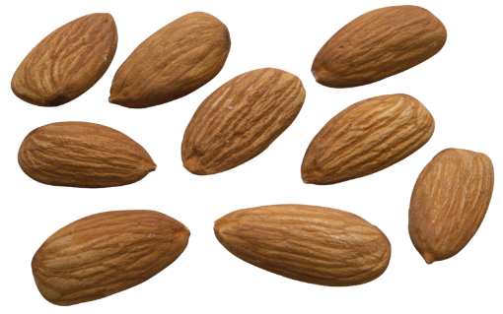
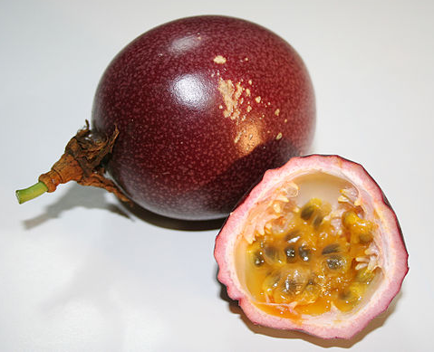
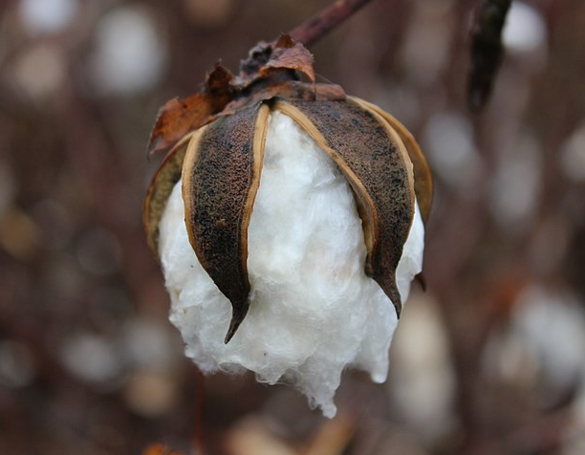
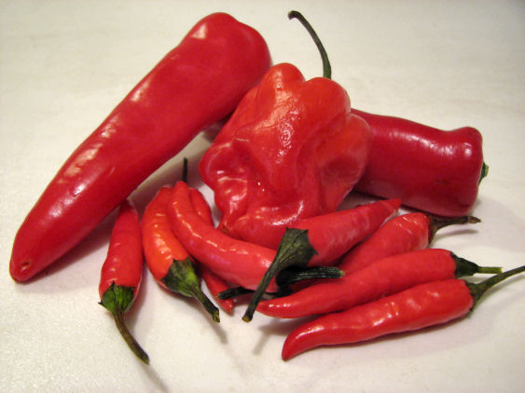
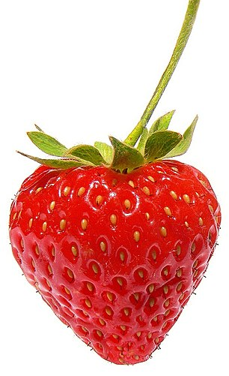
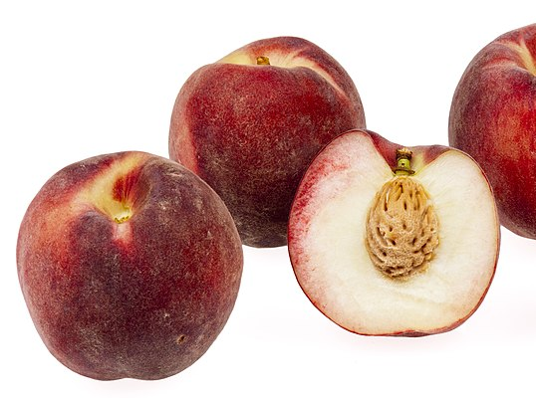
What do these crops have in common?
Notes:
All these crops rely upon bee pollination. Many of the foods we consume daily rely upon pollinators, and bees are one of the predominate pollinators most people are familiar with (flies, moths, and butterflies are important pollinators, too).
https://upload.wikimedia.org/wikipedia/commons/7/7c/Zucchini-Whole.jpg
https://commons.wikimedia.org/wiki/File:Granny_Smith_Apples.jpg
https://commons.wikimedia.org/wiki/File:Starr-070730-7867-Pisum_sativum_var_macrocarpum-snow_peas-Foodland_Pukalani-Maui_(24522893769).jpg
https://commons.wikimedia.org/wiki/File:Kiwi_aka.jpg
https://commons.wikimedia.org/wiki/File:Roasted_coffee_beans.jpg
https://commons.wikimedia.org/wiki/File:Coconut_on_white_background.jpg
https://commons.wikimedia.org/wiki/File:Fuyu_Persimmon_(Diospyros_Kaki).jpg
https://commons.wikimedia.org/wiki/File:Passion_fruit_red2.jpg
https://commons.wikimedia.org/wiki/File:CDC_edamame.jpg
https://commons.wikimedia.org/wiki/File:Blanched_Almonds.png
https://commons.wikimedia.org/wiki/File:Strawberry444.jpg
https://commons.wikimedia.org/wiki/File:Cotton_boll_nearly_ready_for_harvest.jpg

Slide 8
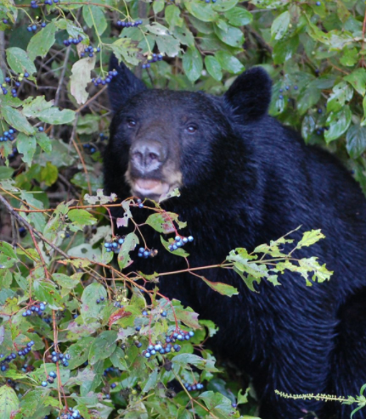
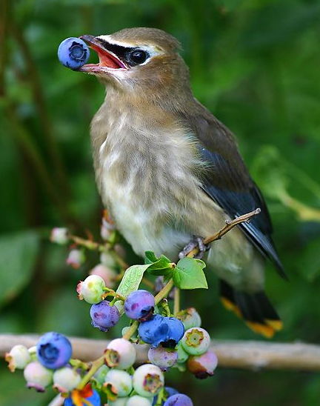
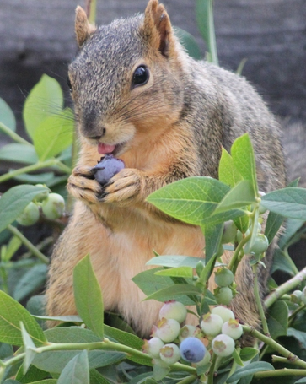
Who else enjoys blueberries?
Blueberry is a common name for fruits in the genus Vaccinium
Notes:
The genus Vaccinium contains blueberries, huckleberries, cranberries, and bilberries. The fruits of these plants play a major role in many ecosystems as they are plentiful late summer and fall sources of calories. Small animals and large animals alike rely upon them.

Slide 9
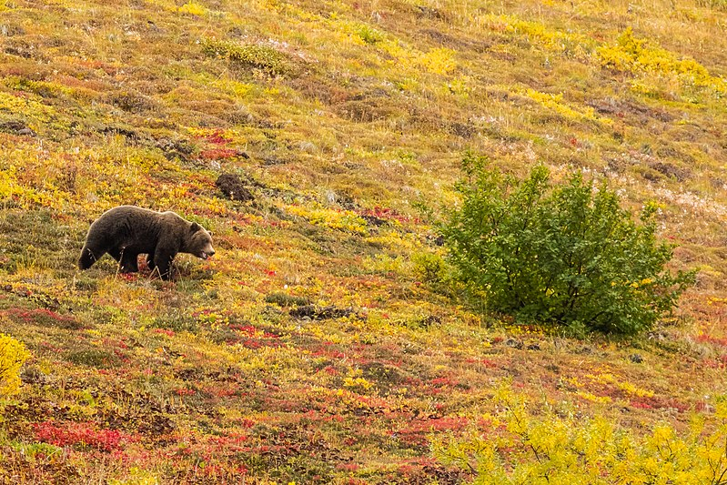
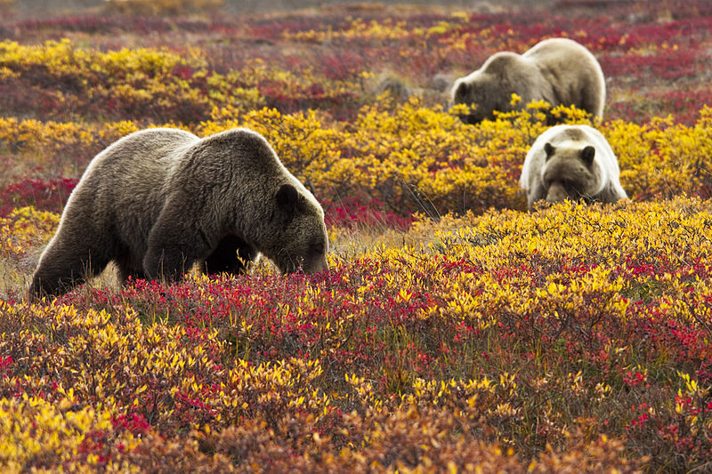
Blueberries are key to many food webs
Provide substantial fall calories to animals large and small
Grizzly bears consume up to 30,000 berries per day June-September
Notes:
When people think of Grizzly Bears, they usually picture the bears eating salmon or hunting other animals. Grizzlies of Alaska’s interior rely on blueberries for a substantial portion of their caloric intake from June through September, when a bear can consume up to 30,000 berries per day. I would not have liked to be the grad student involved in the project that followed bears around for a season picking up their scat and counting blueberries skins!
https://commons.wikimedia.org/wiki/File:Oso_gris_(Ursus_arctos_horribilis),_Parque_nacional_y_reserva_Denali,_Alaska,_Estados_Unidos,_2017-08-30,_DD_77.jpg
https://commons.wikimedia.org/wiki/File:Grizzly_Bears_in_Blueberries_(6187113330).jpg

Slide 10
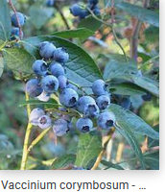
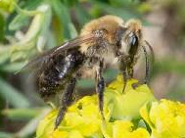
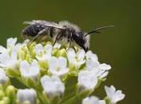
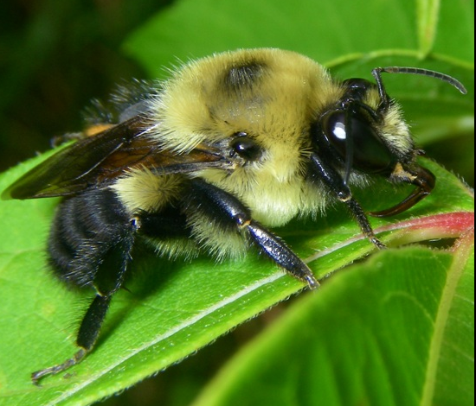
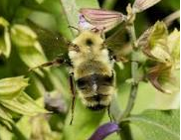
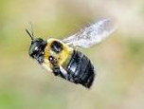
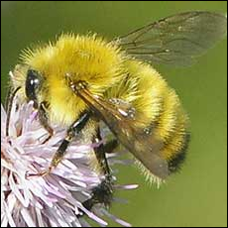
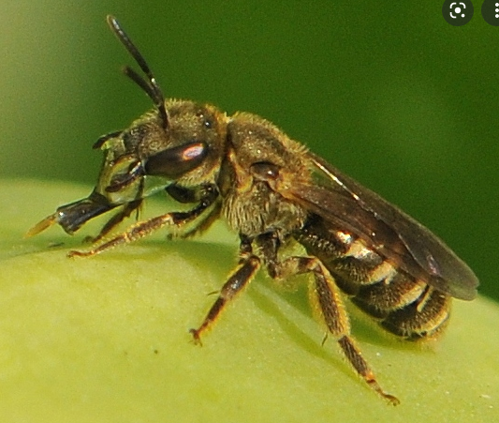
Bee diversity is key to blueberry pollination
In Rhode Island, 41 species of bees pollinate blueberries.
Andrena vicina
Andrena carlini
Bombus griseocollis
Bombus bimaculatus
Xylocopa virginica
Bombus perplexus
Halictus confusus
https://academic.oup.com/ee/article/45/6/1432/2418059?login=true
Notes:
A variety of bees (flying insects in the clade Anthophila) are involved in blueberry pollination. Rhode Island, which has a robust blueberry industry, spent money to figure out who was involved in propping up their crop, and a surprising diversity of bees were found to be involved. This diversity likely contributes to high fruit set rates and the ability to make it through changing weather conditions.

Slide 11
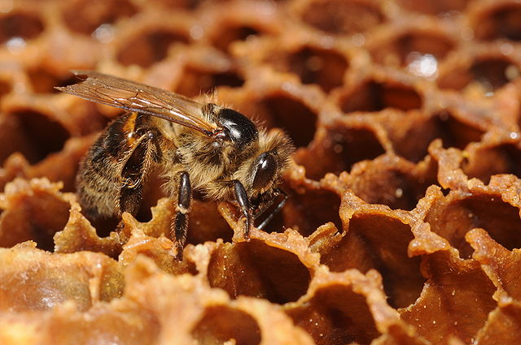
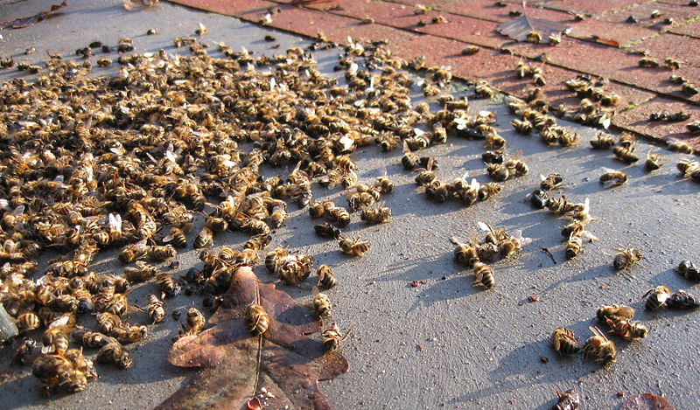
Honeybee decline is just the tip of the iceberg
Notes:
Honeybees make the news because they do two things we like – they give us honey, and they pollinate a variety of crops.
However, the “save the honeybees” campaign is a little like a “let’s save the cows” campaign - honeybees are not a native species, but a species we get to specific goods for ourselves that aren’t necessarily good for the native species operating in the same niche.
https://commons.wikimedia.org/wiki/File:ComputerHotline_-_Apis_mellifera_(by)_(1).jpg
https://commons.wikimedia.org/wiki/File:Deadhoneybees.jpghttps://upload.wikimedia.org/wikipedia/commons/c/c3/Deadhoneybees.jpg

Slide 12
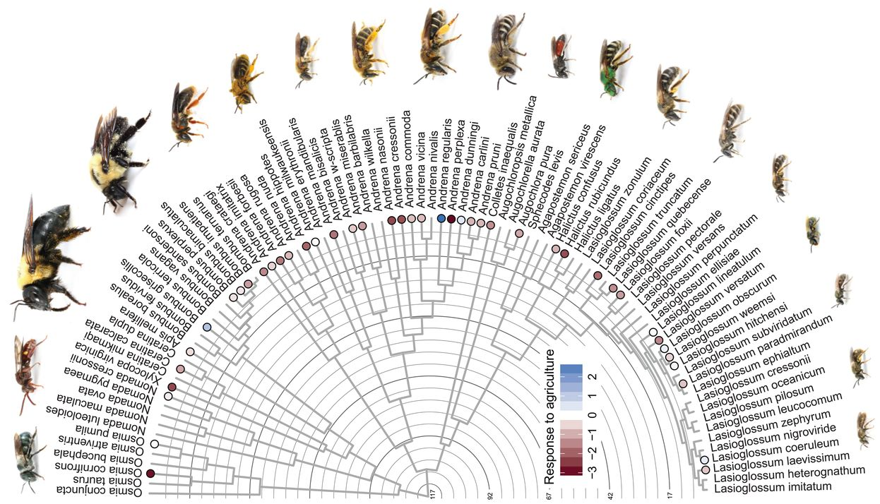
Bee diversity is in decline worldwide
Non-honeybees provide a substantial amount of pollination for crops and of course for ecosystems
20,000+ species of bees worldwide
Some species are undescribed and so understudied, complicating conservation efforts

Slide 13
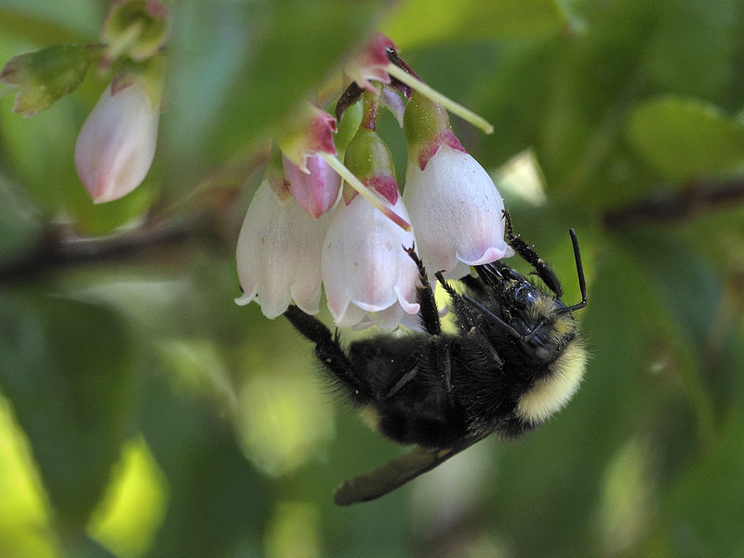
Bumblebees (Genus Bombus)
Agricultural importance
  Active in much cooler weather than honeybees (early spring, cloudy days, etc.)
  Large size and wing vibration make them better pollinators for certain plants
    6X more effective at pollinating blueberries than honeybees
Ecological importance
  Major pollinators for diversity of plants
Conservation
  Major declines
    89% decline of the American Bumblebee (Bombus pensylvanicus)
  >260 species in just the United States
  Identification in the field can be challenging
Notes:
https://commons.wikimedia.org/wiki/File:Evergreen_Huckleberry,_New_River_ACEC_(15083337613).jpg

Slide 14
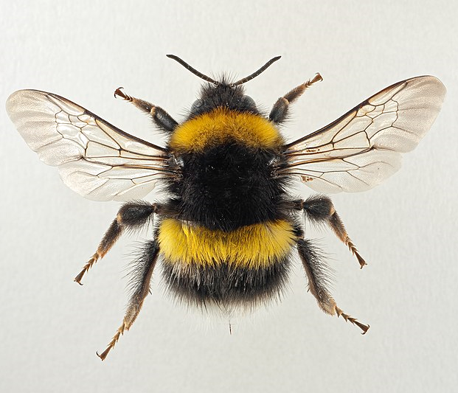
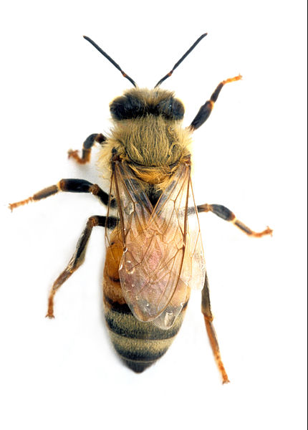
Bumblebee vs Honeybee
(Buzz Pollinator)
(Non- Buzz Pollinator)
Notes:
Bumblebees on average are much larger than honeybees. They have a rounder body and a much higher wing vibration to power the bigger body ….. This happens to make them much better pollinators for a lot of crops (blueberries being one of them): “Buzz Pollination” - A specific frequency is sometimes required to get pollen to release.

Slide 15
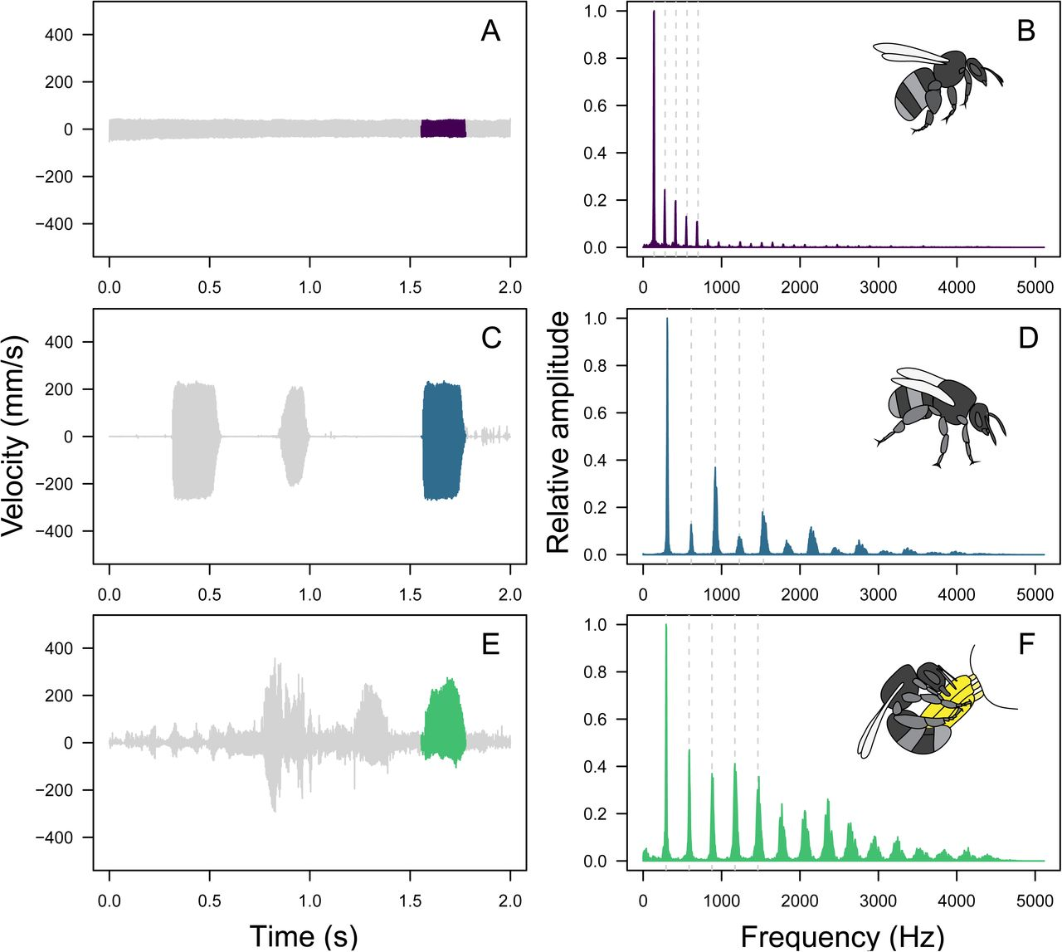
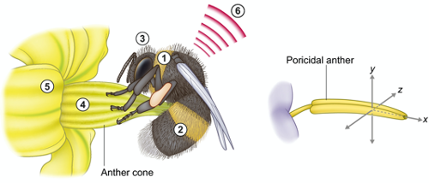
Bumblebees use buzz pollination
Bumblebees and some other native bees use specific frequencies to unlock pollen in many species of plants
Flight
Defense
Pollen unlocking
Notes:
Scientific papers:
https://nph.onlinelibrary.wiley.com/doi/full/10.1111/nph.15666
https://www.biorxiv.org/content/10.1101/2019.12.17.879981v1.full
Videos and briefs:
https://www.pbs.org/video/deep-look-bumblebee/
https://en.wikipedia.org/wiki/Buzz_pollination

Slide 16
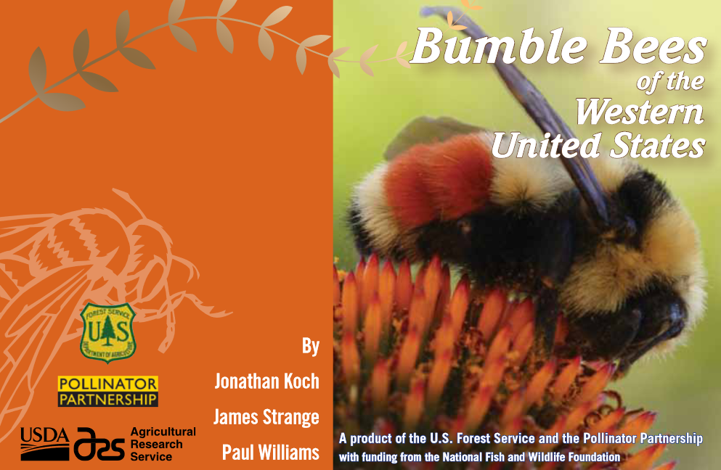
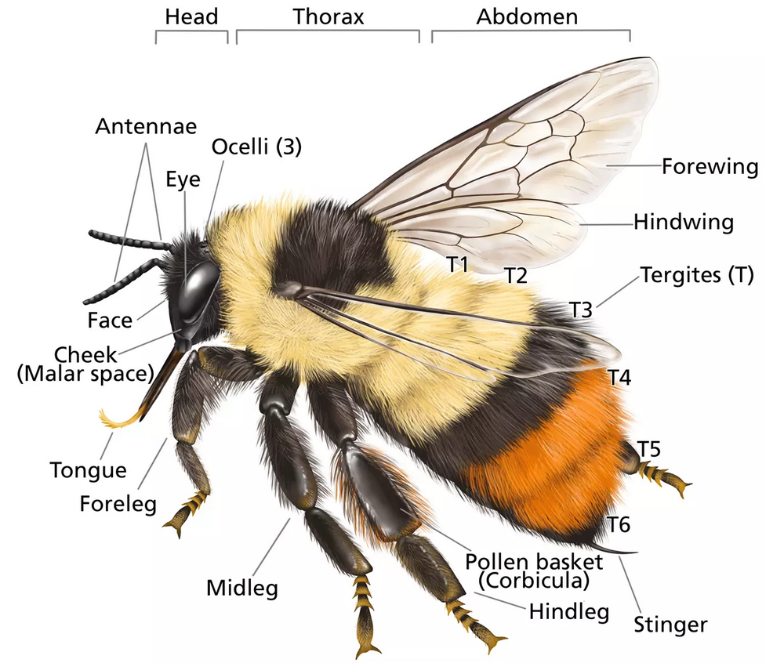
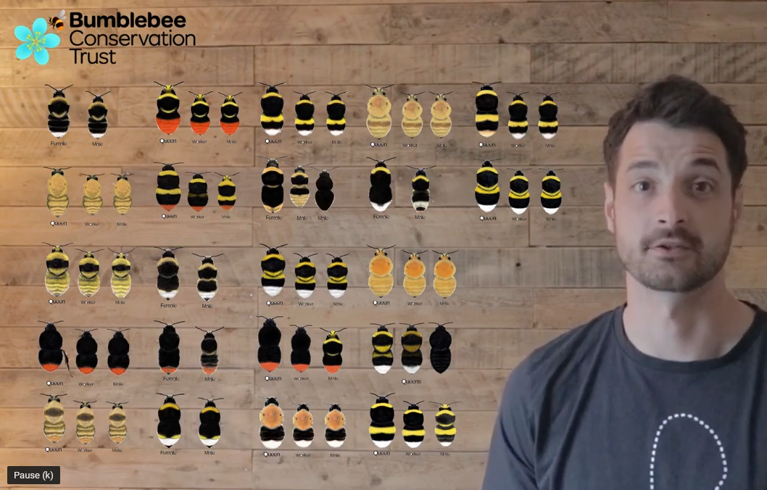
Learning to see bumblebee diversity
(1) Make sure you’ve got a bumblebee: large round bee, usually fluffy, small eyes
(2) Look for anatomical differences
https://xerces.org/sites/default/files/2018-05/12-053_01_Western_BB_guide.pdf
https://www.youtube.com/watch?v=A_6ixf3Ui8U&t=138s

Slide 17



3-Part Game: Identifying Bumblebees of Colorado
Round 1 – Learn to identify one bumblebee
Round 2 – Learn to sort two bumblebees that live in the same habitat
Round 3 – Use a new tool to sort bumblebees that live in the same habitat
Notes:
Images Damon Tighe, flickr

Slide 18



Round 1
Is your bee Bombus huntii?
YES
NO
Unsure
Notes:
How to use with student groups:
Have each group look at their bee observation and decide if it is B. huntii, if it’s not, or if they are unsure. Then as a group discuss how each group reached their conclusion using a CER like structure.
“You choose B. huntii, tell me your reasoning…” etc,
The goal here is not necessarily for them to “guess right” but to go through the process of argumentation for their decision.
Images CC-BY
https://www.inaturalist.org/observations/48046780
https://www.inaturalist.org/observations/8204235

Slide 19

Round 1
Is your bee Bombus huntii?
Group 1
YES
NO
Unsure
Notes:
Images CC-BY
https://www.inaturalist.org/observations/30019030

Slide 20

Round 1
Is your bee Bombus huntii?
Group 2
YES
NO
Unsure
Notes:
Images CC-BY
https://www.inaturalist.org/observations/57344683

Slide 21

Round 1
Is your bee Bombus huntii?
Group 3
YES
NO
Unsure
Notes:
Images CC-BY
https://www.inaturalist.org/observations/91692844

Slide 22

Round 1
Is your bee Bombus huntii?
Group 4
YES
NO
Unsure
Notes:
Images CC-BY
https://www.inaturalist.org/observations/88069420

Slide 23

Round 1
Is your bee Bombus huntii?
Group 5
YES
NO
Unsure
Notes:
Images CC-BY
https://www.inaturalist.org/observations/33855356

Slide 24

Round 1
Is your bee Bombus huntii?
Group 6
YES
NO
Unsure
Notes:
Images CC-BY

Slide 25

Round 1
Is your bee Bombus huntii?
Group 7
YES
NO
Unsure
Notes:
Images CC-BY
https://www.inaturalist.org/observations/33855356

Slide 26

Round 1
Is your bee Bombus huntii?
Group 8
YES
NO
Unsure
Notes:
Images CC-BY
https://www.inaturalist.org/observations/84756180

Slide 27


Round 1
How did you decide?
1
2
3
4
5
6
7
8
Notes:
Bombus huntii = 1,2, and 3

Slide 28

Progression of representations of Bombus
Round 1
Notes:
Goal – give students an impression on how descriptions of Bombus have changed over time.
Originally, we tried to make real-life drawings and then they slowly became oriented to look at banding patterns, and that further derivatized into diagrams that give you just the important factors for determining differences between species.

Slide 29

Progression of representations of Bombus
Round 1
Notes:
https://www.nhm.ac.uk/research-curation/research/projects/bombus/colour.html

Slide 30

Derive a representation
Round 1
Notes:
Goal – step through how these derived representations are built, mainly because we will use these representations in the next round to separate species.
https://www.nhm.ac.uk/research-curation/research/projects/bombus/colour.html

Slide 31
Round 1
Derive a representation
Notes:
Let’s start at the head and work down the body, adding colors where we see them in our examples.

Slide 32






Both occur in CO with overlapping geography
Round 2
Bombus sylvicola
Bombus centralis
Notes:
https://www.nhm.ac.uk/research-curation/research/projects/bombus/colour.html

Slide 33











Round 2
Each team sort bees into bins / zoom stamp
1
2
3
4
5
6
7
8
Bombus sylvicola
Bombus centralis
Bombus sp.
Unsure
Notes:
Photos CC-BY
https://www.inaturalist.org/observations/74113982
https://www.inaturalist.org/observations/88213328
https://www.inaturalist.org/observations/15418132
https://www.inaturalist.org/observations/7011457
https://www.inaturalist.org/observations/87354143
https://www.inaturalist.org/observations/30464900

Slide 34
Round 2
Discussion about sort
1
2
3
4
5
6
7
8
Bombus sp.
Bombus sylvicola
Bombus centralis
Unsure
1,3,4,5,6,8
2, 7
6
Notes:
Photos CC-BY
https://www.inaturalist.org/observations/74113982
https://www.inaturalist.org/observations/88213328
https://www.inaturalist.org/observations/15418132
https://www.inaturalist.org/observations/7011457
https://www.inaturalist.org/observations/87354143
https://www.inaturalist.org/observations/30464900

Slide 35


DNA Barcodes
An approach to identifying species by a short, standardized fragment of their DNA
Cytochrome oxidase I

Slide 36







Round 3
New lens of DNA Barcode, let’s sort together
1
2
3
4
5
6
7
8
Bombus sylvicola
Bombus centralis
Bombus sp.
Unsure
Notes:
Photos CC-BY
https://www.inaturalist.org/observations/74113982
https://www.inaturalist.org/observations/88213328
https://www.inaturalist.org/observations/15418132
https://www.inaturalist.org/observations/7011457
https://www.inaturalist.org/observations/87354143
https://www.inaturalist.org/observations/30464900

Slide 37




Round 3
BLASTN: a tool for comparing sequences
3
4
5
Compare
1
2
6
8
Notes:
Goal – use BLASTN to demonstrate we can see differences in bees using their “DNA Barcodes” CO1 sequence.
Download sequences:
Sequence for Bombus 1.txt: https://www.dropbox.com/s/45v57rcwebqmue7/Sequence%20for%20Bombus%201.txt?dl=0
Sequence for Bombus 2.txt: https://www.dropbox.com/s/m4hkrrctd0kidwh/Sequence%20for%20Bombus%202.txt?dl=0
Photos CC-BY
https://www.inaturalist.org/observations/74113982
https://www.inaturalist.org/observations/88213328
https://www.inaturalist.org/observations/15418132
https://www.inaturalist.org/observations/7011457
https://www.inaturalist.org/observations/87354143
https://www.inaturalist.org/observations/30464900

Slide 38

Round 3
BLASTN: a tool for comparing sequences
3
4
5
How does this compare to your visual sort?
1
8
B. sylvicola
2
B. centralis
Notes:
Goal – highlight the differences we see in the DNA sequence between the 2 species.
Photos CC-BY
https://www.inaturalist.org/observations/74113982
https://www.inaturalist.org/observations/88213328
https://www.inaturalist.org/observations/15418132
https://www.inaturalist.org/observations/7011457
https://www.inaturalist.org/observations/87354143
https://www.inaturalist.org/observations/30464900

Slide 39


Round 3
Phylogeny.fr - a tool for comparing relationships of many individuals based on DNA Barcodes
Notes:
We could do BLASTN for each against each other, but there are automated ways to do that which also can help us see how close they are from an evolutionary perspective.

Slide 40



Data Set:
Adding all our Bombus sequences AND 1 “out group” = Apis mellifera
Copy and paste
*Sequences in slide notes
Notes:
>Bombus_1
TAAAGATATTGGAATAATATATTTTATTTTTGCTATATGATCAGGAATAATTGGATCATCAATAAGATTA
TTAATTCGAATAGAACTTAGTCATCCTGGAATATGAATTAATAATGATCAAGTTTACAATTCATTAATTA
CAAGTCATGCATTTTTAATAATTTTTTTTATAGTTATACCATTTATAATTGGAGGATTTGGAAATTATTT
AATTCCTTTAATATTAGGATCACCTGATATAGCTTTTCCTCGAATAAATAATATTAGATTTTGATTATTA
CCTCCATCTCTTTTTTTGTTACTTTTAAGAACATTATTTTCTCCAAATGCAGGAACAGGTTGAACTGCAT
ATCCACCTTTATCATTAAATATATTTCATTCATCACCATCTATTGATGTTGCAATTTTTTCATTACATAT
AACAGGAATTTCTTCAATTATTGGATCTTTAAATTTTATTGTAACTATTATATTAATAAAAAATTTTTCA
TTAAATTATGATCAAATTAATTTATTCTCTTGATCTGTATGTATTACAGTAATATTATTAATTTTATCTT
TACCAGTTTTAGCAGGAGCAATTACTATACTTCTTTTTGATCGAAATTTTAATACATCATTTTTTGATCC
AATAGGAGGAGGTGATCCAATTCTTTATCAACATTTATTTTGA
>Bombus_2
AATAATATATTTTATTTTCGCTATATGATCAGGAATAATTGGATCATCAATAAGATTATTAATTCGAATA
GAATTAAGACATCCTGGGATATGAATTAATAATGATCAAATTTATAATTCATTAGTTACTAGACATGCAT
TTTTAATAATTTTCTTTATAGTTATACCATTTATAATTGGAGGATTCGGAAATTATTTAATTCCTTTAAT
ATTAGGAGCTCCTGATATAGCTTTTCCACGAATGAATAATATTAGATTTTGATTACTTCCTCCATCTCTT
TTAATATTACTTTTAAGAAATTTATTTACACCAAATGTTGGTACAGGATGAACTGTTTATCCTCCTTTAT
CATCATATATATTTCATTCATCACCTTCAATTGATATTGCAATTTTTTCTTTACATATAACAGGTATTTC
TTCAATTATTGGATCTTTAAATTTTATTGTAACTATTATATTAATAAAAAATTTTTCATTAAATTATGAT
CAAATTAATTTATTTTCTTGATCAGTATGTATTACAGTAATTTTATTAATTTTATCTTTACCAGTTTTAG
CAGGAGCTATTACAATACTTCTTTTTGATCGAAATTTTAATACATCTTTTTTTGATCCAATAGGAGGAGG
TGATCCAATTCTTTATCAACATTTATTT
>Bombus_3
TAAAGATATTGGAATAATATATTTTATTTTTGCTATATGATCAGGAATAATTGGATCATCAATAAGATTA
TTAATTCGAATAGAACTTAGTCATCCTGGAATATGAATTAATAATGATCAAGTTTATAATTCATTAATTA
CAAGTCATGCATTTTTAATAATTTTTTTTATAGTTATACCATTTATAATTGGAGGATTTGGAAATTATTT
AATTCCTTTAATATTAGGATCACCTGATATAGCTTTTCCTCGAATAAATAATATTAGATTTTGATTATTA
CCTCCATCTCTTTTTTTGTTACTTTTAAGAACATTATTTTCTCCAAATGCAGGAACAGGTTGAACTGCAT
ACCCACCTTTATCATTAAATATATTTCATTCATCACCATCTATTGATATTGCAATTTTTTCATTACATAT
AACAGGAATTTCTTCAATTATTGGATCTTTAAATTTTATTGTAACTATTATATTAATAAAAAATTTTTCA
TTAAATTTTGATCAAATTAATTTATTTTCTTGATCTGTATGTATTACAGTAATATTATTAATTTTATCTT
TACCAGTTTTAGCAGGAGCAATTACTATACTCCTTTTTGATCGAAATTTTAATACATCATTTTTTGACCC
AATAGGAGGAGGTGATCCAATTCTTTATCA
>Bombus_4
TAAAGATATTGGAATAATATATTTTATTTTTGCTATATGATCAGGAATAATTGGATCATCAATAAGATTA
TTAATTCGAATAGAACTTAGTCATCCTGGAATATGAATTAATAATGATCAAGTTTATAATTCATTAATTA
CAAGTCATGCATTTTTAATAATTTTTTTTATAGTTATACCATTTATAATTGGAGGATTTGGAAATTATTT
AATTCCTTTAATATTAGGATCACCTGATATAGCTTTTCCTCGAATAAATAATATTAGATTTTGATTATTA
CCTCCATCTCTTTTTTTGTTACTTTTAAGAACATTATTTTCTCCAAATGCAGGAACAGGTTGAACTGCAT
ACCCACCTTTATCATTAAATATATTTCATTCATCACCATCTATTGATATTGCAATTTTTTCATTACATAT
AACAGGAATTTCTTCAATTATTGGATCTTTAAATTTTATTGTAACTATTATATTAATAAAAAATTTTTCA
TTAAATTTTGATCAAATTAATTTATTTTCTTGATCTGTATGTATTACAGTAATATTATTAATTTTATCTT
TACCAGTTTTAGCAGGAGCAATTACTATACTCCTTTTTGATCGAAATTTTAATACATCATTTTTTGACCC
AATAGGAGGAGGTGATCCAATTCTTTATCA
>Bombus_5
TAAAGATATTGGAATAATATATTTTATTTTTGCTATATGATCAGGAATAATTGGATCATCAATAAGATTA
TTAATTCGAATAGAACTTAGTCATCCTGGAATATGAATTAATAATGATCAAGTTTACAATTCATTAATTA
CAAGTCATGCATTTTTAATAATTTTTTTTATAGTTATACCATTTATAATTGGAGGATTTGGAAATTATTT
AATTCCTTTAATATTAGGATCACCTGATATAGCTTTTCCTCGAATAAATAATATTAGATTTTGATTATTA
CCTCCATCTCTTTTTTTGTTACTTTTAAGAACATTATTTTCTCCAAATGCAGGAACAGGTTGAACTGCAT
ATCCACCTTTATCATTAAATATATTTCATTCATCACCATCTATTGATGTTGCAATTTTTTCATTACATAT
AACAGGAATTTCTTCAATTATTGGATCTTTAAATTTTATTGTAACTATTATATTAATAAAAAATTTTTCA
TTAAATTATGATCAAATTAATTTATTCTCTTGATCTGTATGTATTACAGTAATATTATTAATTTTATCTT
TACCAGTTTTAGCAGGAGCAATTACTATACTTCTTTTTGATCGAAATTTTAATACATCATTTTTTGATCC
AATAGGAGGAGGTGATCCAATTCTTTATCAACATTTATTTTGA
>Bombus_6
TAAAGATATTGGAATAATATATTTTATTTTTGCTATATGATCAGGAATAATTGGATCATCAATAAGATTA
TTAATTCGAATAGAACTTAGTCATCCTGGAATATGAATTAATAATGATCAAGTTTACAATTCATTAATTA
CAAGTCATGCATTTTTAATAATTTTTTTTATAGTTATACCATTTATAATTGGAGGATTTGGAAATTATTT
AATTCCTTTAATATTAGGATCACCTGATATAGCTTTTCCTCGAATAAATAATATTAGATTTTGATTATTA
CCTCCATCTCTTTTTTTGTTACTTTTAAGAACATTATTTTCTCCAAATGCAGGAACAGGTTGAACTGCAT
ATCCACCTTTATCATTAAATATATTTCATTCATCACCATCTATTGATGTTGCAATTTTTTCATTACATAT
AACAGGAATTTCTTCAATTATTGGATCTTTAAATTTTATTGTAACTATTATATTAATAAAAAATTTTTCA
TTAAATTATGATCAAATTAATTTATTCTCTTGATCTGTATGTATTACAGTAATATTATTAATTTTATCTT
TACCAGTTTTAGCAGGAGCAATTACTATACTTCTTTTTGATCGAAATTTTAATACATCATTTTTTGATCC
AATAGGAGGAGGTGATCCAATTCTTTATCAACATTTATTTTGA
>Bombus_7
AATAATATATTTTATTTTCGCTATATGATCAGGAATAATTGGATCATCAATAAGATTATTAATTCGAATA
GAATTAAGACATCCTGGGATATGAATTAATAATGATCAAATTTATAATTCATTAGTTACTAGACATGCAT
TTTTAATAATTTTCTTTATAGTTATACCATTTATAATTGGAGGATTCGGAAATTATTTAATTCCTTTAAT
ATTAGGAGCTCCTGATATAGCTTTTCCACGAATGAATAATATTAGATTTTGATTACTTCCTCCATCTCTT
TTAATATTACTTTTAAGAAATTTATTTACACCAAATGTTGGTACAGGATGAACTGTTTATCCTCCTTTAT
CATCATATATATTTCATTCATCACCTTCAATTGATATTGCAATTTTTTCTTTACATATAACAGGTATTTC
TTCAATTATTGGATCTTTAAATTTTATTGTAACTATTATATTAATAAAAAATTTTTCATTAAATTATGAT
CAAATTAATTTATTTTCTTGATCAGTATGTATTACAGTAATTTTATTAATTTTATCTTTACCAGTTTTAG
CAGGAGCTATTACAATACTTCTTTTTGATCGAAATTTTAATACATCTTTTTTTGATCCAATAGGAGGAGG
TGATCCAATTCTTTATCAACATTTATTT
>Bombus_8
TAAAGATATTGGAATAATATATTTTATTTTTGCTATATGATCAGGAATAATTGGATCATCAATAAGATTA
TTAATTCGAATAGAACTTAGTCATCCTGGAATATGAATTAATAATGATCAAGTTTACAATTCATTAATTA
CAAGTCATGCATTTTTAATAATTTTTTTTATAGTTATACCATTTATAATTGGAGGATTTGGAAATTATTT
AATTCCTTTAATATTAGGATCACCTGATATAGCTTTTCCTCGAATAAATAATATTAGATTTTGATTATTA
CCTCCATCTCTTTTTTTGTTACTTTTAAGAACATTATTTTCTCCAAATGCAGGAACAGGTTGAACTGCAT
ATCCACCTTTATCATTAAATATATTTCATTCATCACCATCTATTGATGTTGCAATTTTTTCATTACATAT
AACAGGAATTTCTTCAATTATTGGATCTTTAAATTTTATTGTAACTATTATATTAATAAAAAATTTTTCA
TTAAATTATGATCAAATTAATTTATTCTCTTGATCTGTATGTATTACAGTAATATTATTAATTTTATCTT
TACCAGTTTTAGCAGGAGCAATTACTATACTTCTTTTTGATCGAAATTTTAATACATCATTTTTTGATCC
AATAGGAGGAGGTGATCCAATTCTTTATCAACATTTATTTTGA
>Apis mellifera
ATTTTAATTGGAGGATTTGGAAATTGACTTATTCCTTTAATACTAGGATCACCTGATATAGCATTTCCTC
GAATAAATAATATTAGATTTTGATTACTTCCTCCCTCATTATTTATACTTTTATTAAGAAATTTATTTTA
TCCAAGACCAGGAACTGGGTGAACAGTATATCCACCATTATCAGCATATTTATATCATTCTTCACCTTCA
GTAGATTTTGCAATTTTTTCTCTTCATATATCAGGAATTTCCTCAATTATAGGATCATTAAACTTAATAG
TTACAATTATAATAATAAAAAATTTTTCTATAAATTATGACCAAATTTCATTATTTCCATGATCAGTTTT
CATTACAGCAATTTTATTAATTATATCATTACCTGTATTAGCTGGAGCAATTACTATACTATTATTTGAT
CGAAATTTTAATACATCATTTTTCGATCCTATAGGAGGTGGAGATCCAATTTTATATCAACATTTATTTT
GATTTTTTGGTCATCCAGAAGTTTATATTTTAATTTTACCTGGATTTGGATTAATCTCTCATATTGTAAT
AAATGAAAGAGGAAAAAAAGAAATTTTTGGTAATTTAAGAATAATTTATGCAATATTAGGAATTGGATTC
CTAGGTTTCATTGTTTGAGCACATCATATATTTACAGTTGGATTAGATGTTGATACTCGAGCATATTTTA
CTTCAGCAACAATAATCATTGCTGTACCAACAGGAATTAAAGTTTTTAGATGATTAGCAACTTATCATGG
TTCAAAATTAAAATTAAATATTTCAATTTTATGATCACTAGGTTTTATTATACTATTTACTATTGGTGGA
TTAACAGGAATTATATTATCAAATTCTTCTATTGATATTATTCTTCATGATACATATTACGTTGTTGGAC
ATTTTCATTATGTTCTTTCAATAGGTGCAGTATTTGCAATTATTTCAAGATTTATTCATTGATATCCATT
AATTACTGGATTATTATTAAATATTAAATGATTAAAAATTCAATTTATTATAATATTTATTGGA

Slide 41

Round 3
???
B. sylvicola
B. centralis
What does this mean?
Notes:
What was our out group? = Apis mellifera, the honeybee and yes it seems to be out there on its own
Which ones did we think were Bombus centralis? = 2 & 7
… they seem to form their own grouping, that’s good to see
Which ones were Bombus sylvicola? =1,3,4,5,6,8
…. That’s weird that they aren’t all grouping together….
What could we use to compare these two groups in more details….base by base detail?

Slide 42

Round 3
BLASTN of our two Bombus “sylvicola” groups
1
7 bases different…
3
Is this significant?

Slide 43


Seeing species hiding in plain sight
Bombus incognitus
Notes:
Apparently, it is significant enough for a group to publish that they found a new species, hiding in plain sight.
https://academic.oup.com/mbe/article/38/8/3126/6199435

Slide 44

B. icognitus and B. sylvicola found in same habitat
Notes:
https://academic.oup.com/mbe/article/38/8/3126/6199435
https://vivadifferences.com/8-difference-between-allopatric-speciation-and-sympatric-speciation-with-examples/

Slide 45

What are we seeing with B. icognitus and B. sylvicola?
What might be driving this speciation event?
Notes:
https://academic.oup.com/mbe/article/38/8/3126/6199435
https://vivadifferences.com/8-difference-between-allopatric-speciation-and-sympatric-speciation-with-examples/

Slide 46

What may be driving this speciation event?
What geographical features may give more insight?
What biological features may give more insight?
Chihuahua Basin near Mt. Evans sampling site

Slide 47


Recognizing species makes it possible
to study and conserve them
We rely upon other species for our well being
They cycle nutrients
Help produce crops
And much more…
Notes:
https://en.wikipedia.org/wiki/File:Nitrogen_Cycle_2.svg
https://en.wikipedia.org/wiki/File:Dish_of_blueberries.jpg

Slide 48


We don’t recognize many species…
MICROBES
?
Known biodiversity:
1.7 million species of
plants and animals
Estimated biodiversity:
10 million to
100 million species

Slide 49

Explore biodiversity and contribute to
recognizing new species
Appropriate controls
Fast, high quality DNA extraction method
Dyes in primers make it easy to visually check process

Slide 50

Organisms verified to work with this kit

Slide 51


Slide 52


Slide 53


High-quality DNA isolation increases PCR success
Spin columns ensure removal of inhibitors and maximum amount of DNA isolated
Fast (~10 minutes)

Slide 54

M13 primer tails make sequencing easy
Most sequencing facilities have these primers, so no need to send primers

Slide 55





Success stories
High School in partnership with local land agencies, surveying mushrooms since 2016

Slide 56



Success stories
~20% of the sequences they generated were novel compared to GenBank
Some of their mushrooms >10% different than anything else in Genbank!

Slide 57




Success stories

Slide 58



Success stories
Barcoding uncovers range extensions
Novel Lepiota species

Slide 59


Make your own discoveries in biodiversity
bio-rad.com/barcoding

