Slide 1
pGLO Bacterial Transformation Kit Modifications for Socially-Distanced Classrooms
Use the pGLO plasmid to transform bacteria to express green fluorescent protein (GFP) from the bioluminescent jellyfish Aequorea victoria, which causes the bacteria to glow green under UV light. Explore the concept of DNA > RNA > Protein > Trait and the roles that external and internal factors play in gene regulation.
Each kit contains sufficient reagents for 8 workstations of 4 students. When modified for individual use, the kit can accommodate up to 24 workstations, with each performing one of the four transformations. Students pool results to see a complete experiment.
Summary of Modifications
Each workstation performs one of the four transformations, and the class pools their results (or groups of 4 pool results to see the complete experimental design).
Students share starter plates, water bath, floats, UV light source.
A variety of online resources are available at bio-rad.com/teachpGLO.
The modifications for socially-distanced classrooms include:
Changes to teacher instructions for packaging the reagents for individual use
Small changes to the student protocol
Ordering Information
1660003EDU pGLO Bacterial Transformation Kit
To see our solutions for other kits…
Download the guide Solutions for Socially-Distanced Classrooms

Slide 2
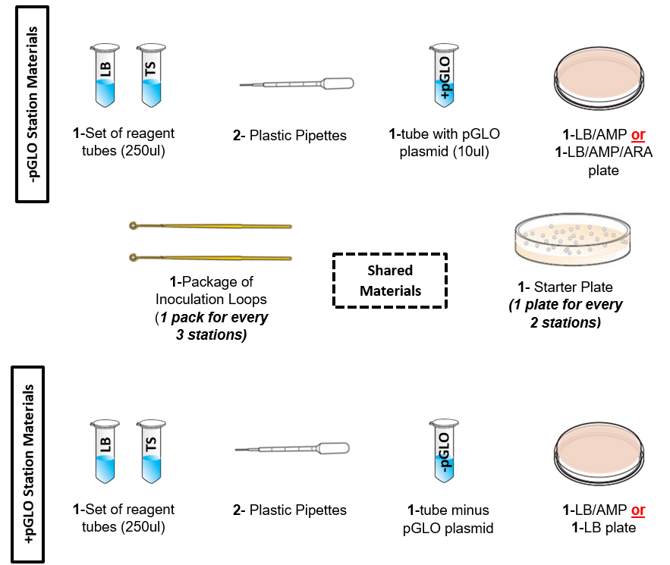
pGLO Bacterial Transformation Kit Modified Teacher Preparation Guide
Download the pGLO Bacterial Transformation Kit Instructor Manual. Follow the teacher prep instructions on pages 13-17 with the modifications noted below.
Modify aliquoting instructions:
250 µl transformation solution in microtubes
250 µl Luria broth in microtubes
10 µl pGLO plasmid solution in 12 microtubes labeled ”+pGLO”
12 microtubes labelled “-pGLO”
Prepare 6 LB, 6 LB/AMP, 12 LB/AMP/ARA and 16 starter plates
Set up 24 student stations:
12 “+pGLO” stations (6 with 1 LB/AMP plate & 6 with one LB/AMP/ARA plate)
12 “-Pglo” stations (6 with 1 LB/AMP plate & 6 with 1 LB plate)
Lab space: in the classroom
Number of workstations: 24
Additional Materials Required
Water bath with foam floats inside
Permanent markers for each student station
UV light source (pen or wand) to be shared by students
Crushed ice in small beaker or cup for each student station

Slide 3
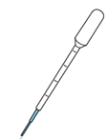
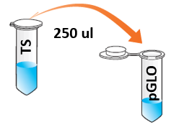
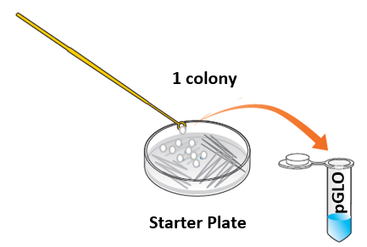
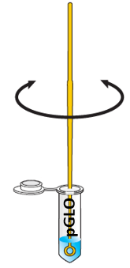
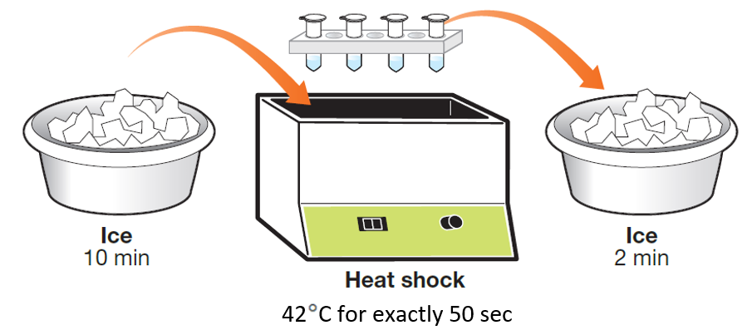
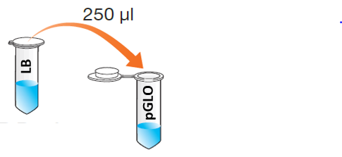
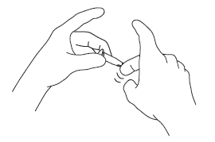
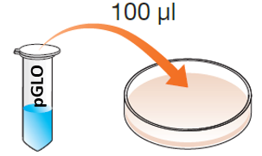
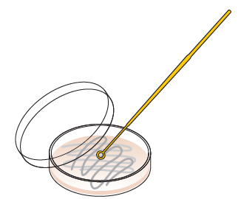
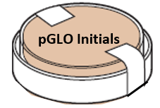
pGLO Bacterial Transformation Kit Modified Student Quick Guide
Find the tube labeled either “+pGLO” or “–pGLO” and write your initials on the top of the tube.
Using a fresh pipet, transfer 250 µl transformation solution (TS) to your pGLO tube and place it on ice.
Using a sterile loop, pick up a single colony of bacteria from the starter plate provided by the instructor. Transfer the colony to the TS solution in your pGLO tube and spin the loop to dislodge the colony.
Incubate the tube on ice for 10 minutes.
During the incubation, label the agar plate with your initials and either “–pGLO” or “+pGLO” to correspond with your tube.
Heat shock. Transfer your microtube into one of the floatie slots in the 42⁰C water bath for exactly 50 sec. Then immediately transfer it to ice for 2 min.
Remove the tube from the ice and add 250 µl Luria broth (LB) using a fresh plastic pipet.
Incubate the tube at room temperature for 10 min.
Flick the tube with your fingers to mix the contents.
Using the LB pipet, transfer 100 µl of your cell suspension to the agar plate.
Use a new, sterile loop to spread the suspension evenly across your plate.
Invert the plate and place it into the incubator for 24 hr.
After 24 hr, view your plate under a UV light source provided by your instructor and record your results.

