Slide 1
Giant Panda Problem Kit Modifications for Socially-Distanced Classrooms
Students become conservation scientists as they learn about the natural and human forces that have contributed to declining giant panda populations and the current efforts to restore them. Students also learn how the unique properties of antibodies have revolutionized diagnostics as they apply two variations of an enzyme-linked immunosorbent assay (ELISA): the first checks simulated panda urine samples for biomarkers of a pregnancy complication, and the second predicts ovulation times.
Each kit contains sufficient reagents for 12 workstations of 4 students. When modified for individual use, the kit serves up to 11 workstations or 22 if additional transfer pipets are provided.
Summary of Modifications
Use the paper model activity and other online resources available at bio-rad.com/classroomresources.
For at-home use, provide PBS wash buffer in a 50 ml tube (not provided).
Each workstation analyzes controls and samples in duplicate, not triplicate.
Students can use disposable plastic transfer pipets instead of micropipets; purchase additional disposable plastic transfer pipets to extend to 22 workstations.
The modifications for socially-distanced classrooms include:
Changes to teacher instructions for packaging the reagents for individual use
Small changes to the student protocol
Ordering Information
17002878EDU Giant Panda Problem Kit
1660480EDU Disposable Plastic Transfer Pipets, nonsterile, pkg of 500
To see our solutions for other kits…
Download the guide Solutions for Socially-Distanced Classrooms

Slide 2
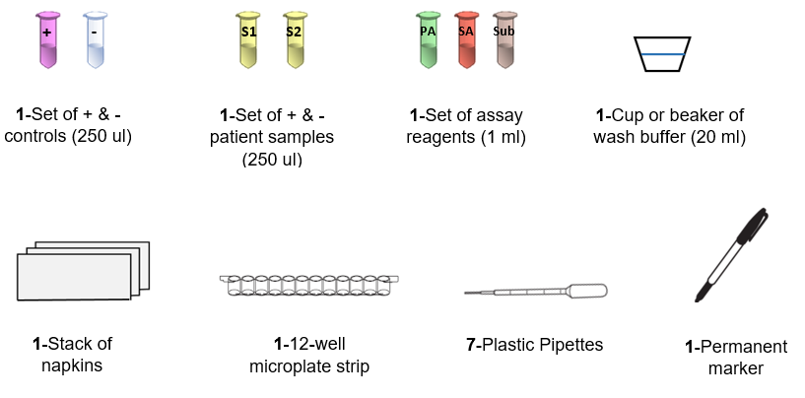
Giant Panda Problem Kit Modified Teacher Preparation Guide
Download the ELISA Immuno Explorer Kit Instuctor Manual. Follow the teacher prep instructions on pages 16-18 with the modifications noted below.
Prepare 3x the amount of positive control reagent: combine 22.5 ml 1x PBS and 450 µl 50x antigen (page 17).
Aliquot reagents to reflect the volumes specified in the layout:
250 µl each of both controls (+ and –) in microtubes
250 µl panda samples in microtubes
1 ml each of assay reagents (PA, SA & Sub) in microtubes
20 ml wash buffer
In small cup or beaker for in-class use
In 50 ml conical tube (not included) for at-home use
Each station should contain the following items:
Lab space: at home or in the classroom
Number of workstations: 11 or 22
Each kit provides supplies sufficient for 11 workstations. To extend to 22 workstations, purchase additional disposable plastic transfer pipets (1660480EDU Disposable Plastic Transfer Pipets, nonsterile, pkg of 500).
Additional Materials Required
For Classroom Use (each station)
Small plastic/paper cup or beaker for wash buffer
Permanent marker
Napkin stack
For At-Home Use
50 ml conical tubes for wash buffer
Permanent marker
Stack of napkins
1-Cup or beaker with wash buffer (20 ml)
-or-
1-50 ml conical tube with wash buffer (20 ml)
7-8-Plastic pipets

Slide 3
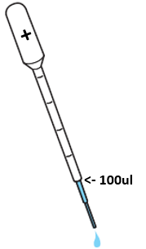
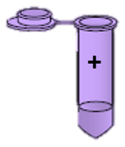
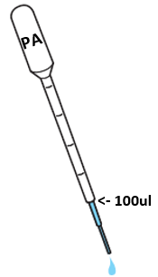
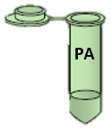
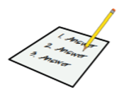
Giant Panda problem Kit Modified Student Quick Guide
1. Label the 12-well strip: label the first 2 wells with a “+” for the positive controls, the next 2 wells with a “–” for the negative controls and the next 4 wells according to your teacher's instructions.
2. Label a new pipet "+" and use it to transfer 100 µl of the positive control (+) into the two “+” wells.
3. Label another new pipet "-" and use it to transfer 100 µl of the negative control (-) into the two “-” wells.
4. Label 1-2 other new pipets according to your teacher's instructions and use it/them to transfer 100 µl of the panda samples in the yellow microtubes into their respective wells.
5. Incubate for 5 minutes at room temperature.
6. WASH STEPS: (a) Tip the microplate strip upside-down onto the paper towels, and gently tap the strip a few times. Avoid splashing samples back into wells. (b) Discard the top paper towel. (c) Label a new transfer pipet "WB" and use it to fill each well with wash buffer, taking care not to spill over into neighboring wells. (d) Tip the microplate strip upside down onto the paper towels and tap. (e) Discard the top 2–3 paper towels. Repeat steps b–d for a second wash.
7. Label a new pipet "PA" and use it to transfer 100 µl of primary antibody (PA) into all 8 wells of the microplate strip. Repeat steps 5 and 6.
8. Label a new pipet "SA" and use it to transfer 100 µl of secondary antibody (SA) into all 8 wells of the microplate strip. Repeats steps 5 (once) and 6 (three times).
9. Label a new pipet "SUB" and use it to transfer 100 µl of enzyme substrate (SUB) into all 8 wells of the microplate strip.
10. Wait 5 minutes. Observe and record the results.

