Slide 1
Detecting SARS-CoV-2 using Real-Time PCR
Simulated using Bio-Rad’s Crime Scene Investigator PCR Basics Real-Time PCR Starter Kit
BIO-RAD is a trademark of Bio-Rad Laboratories, Inc. in certain jurisdictions. All trademarks used herein are the property of their respective owner.
© 2022 Bio-Rad Laboratories, Inc.
Notes:
verB

Slide 2
Contents
Getting
Started
Getting Started
Instructor Preparation
Student Slides
Introduction
Additional Resources
Required Materials
Adaptation Overview
Adaptation Instructions
Anticipated Results
Scenario
Your Task
Procedure

Slide 3
Introduction
Getting
Started
Bio-Rad’s Crime Scene Investigator PCR Basics Real Time PCR Starter Kit allows your students to explore how real time PCR works using actual DNA samples. The scenario presented here is a simulation. No patient samples or human DNA are used.
This slide deck provides information for how use the kit to teach real-time PCR in the context of COVID-19. Be sure to check the speaker’s notes below each slide for more information.
Detection
Quantitation
Identification

Slide 4
Introduction
Getting
Started
Bio-Rad’s Crime Scene Investigator PCR Basics Real Time PCR Starter Kit can easily be adapted to teach real-time PCR in the context of SARS-CoV-2 detection.
This adaption is based on the article Optimization of primer sets and detection protocols for SARS-CoV-2 of coronavirus disease. In the article, Park et al. discuss primer design for a SYBR® based diagnostic test using the same instrumentation as those that use TaqMan probes.
In this activity, students will follow the general approach presented in the article to determine whether simulated patient samples are positive for SARS-CoV-2.
Visit bio-rad.com/teachingresources for more background information about real-time PCR and other useful classroom resources.
Park, M., Won, J., Choi, B.Y. et al. Optimization of primer sets and detection protocols for SARS-CoV-2 of coronavirus disease 2019 (COVID-19) using PCR and real-time PCR. Exp Mol Med 52, 963–977 (2020). https://doi.org/10.1038/s12276-020-0452-7

Slide 5
Required Materials
Instructor Preparation
Crime Scene Investigator PCR Basics Real-Time PCR Starter Kit (16602660EDU)
Required accessories not included in kit:
SsoAdvanced Universal SYBR® Green Supermix, 200 x 20 µl rxns, 2 ml (2 x 1 ml) (1725270EDU) | 1
PCR-grade water (proteomics-grade water is also acceptable, 1632091EDU) | 1
2–20 µl Adjustable volume pipet (1660506EDU) and tips with aerosol barrier (2112006EDU) | 1–8
20–200 µl Adjustable volume pipet (1660507EDU) and tips with aerosol barrier (2112016EDU) | 1
Microcentrifuge (12011919EDU) | 1–4
Real-time PCR system (for example, 12016265EDU) | 1
Note: for this activity, replace the iQ Supermix in the kit with SsoAdvanced Universal SYBR® Green Supermix

Slide 6
Adaptation Overview
Instructor Preparation
Download the Real-Time PCR Application Note, which includes laboratory setup information.
Replace the crime scene scenario with the following: students are evaluating a protocol that uses real-time PCR to determine whether patients have SARS-CoV-2.
Each student group will each examine two patient samples. Both patients are positive for SARS-CoV-2. Patient 2 has higher viral levels than patient 1.
GAPDH will be used as a control locus to verify RNA extraction, subsequent reverse transcription, and amplification. If GAPDH does not amplify for a patient, then the results of the detection are inconclusive.
The master mix included in the kit will be divided into SARS-CoV-2 primers (MMS) and GAPDH primers (MMG).

Slide 7
Adaptation Instructions
Instructor Preparation
Follow the instructions in the Crime Scene Investigator PCR Basics Real Time PCR Application Note to set up Laboratory 1 plus the following modifications.
Reconfigure Suspect D (need three tubes of 1:10,000 Suspect D: +G, P1G, and P2G):
Transfer 10 µl to a 1.5 ml tube labeled 1:100G containing 990 µl distilled water. Pipet to mix.
Transfer 10 µl 1:100G to a 1.5 ml tube labeled P1G containing 990 µl distilled water. Pipet to mix.
Transfer 300 µl P1G to a 1.5 ml tube labeled P2G.
Transfer 300 µl P1G to a 1.5 ml tube labeled +G.
Reconfigure Crime Scene:
Rename as +S and transfer 10 µl to a 1.5 ml tube labeled P1S containing 990 µl distilled water. Pipet to mix.
Prepare master mix using 2x SsoAdvanced SYBR® Green supermix as instructed, then divide equally between two tubes: MMS for SARS-CoV-2 primers and MMG for GAPDH primers.
Sample | DNA source | Label
Positive control, SARS-CoV-2 | Crime Scene DNA | +S
Positive control, GAPDH | 10,000-fold dilution of Suspect D | +G
Patient 1, SARS-CoV-2 | 100-fold dilution of Crime Scene | P1S
Patient 1, GAPDH | 10,000-fold dilution of Suspect D | P1G
Patient 2, SARS-CoV-2 | Suspect C | P2S
Patient 2, GAPDH | 10,000-fold dilution of Suspect D | P2G
Suspects A and B will not be used in this activity.
Notes:
The CSI kit includes 25 μl of Crime Scene Investigator primers (blue, 50x). The kit activity requires 800 ul master mix.
Add 20 ul primers to 1 tube (1 ml) of SsoAdvanced to make the master mix for this activity. You can then safely aliquot 120 ul per workstation (8 workstations), which will each need 100 ul Master Mix.

Slide 8
Adaptation Instructions
Instructor Preparation
Use this revised plate setup.
 | 1 | 2 | 3 | 4 | 5 | 6 | 7 | 8
A | NTCS | NTCG | +S | +G | P1S | P1G | P2S | P2G
B | NTCS | NTCG | +S | +G | P1S | P1G | P2S | P2G
C | NTCS | NTCG | +S | +G | P1S | P1G | P2S | P2G
D | NTCS | NTCG | +S | +G | P1S | P1G | P2S | P2G
E | NTCS | NTCG | +S | +G | P1S | P1G | P2S | P2G
F | NTCS | NTCG | +S | +G | P1S | P1G | P2S | P2G
G | NTCS | NTCG | +S | +G | P1S | P1G | P2S | P2G
H | NTCS | NTCG | +S | +G | P1S | P1G | P2S | P2G

Slide 9
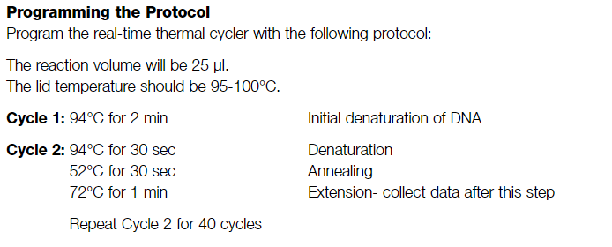
Adaptation Instructions
Instructor Preparation
Use the cycling parameters from Laboratory 1, repeated here.
Notes:
Using the cycling parameters from Laboratory 1 will result in additional PCR products that do not fit the scenario. However, the PCR itself should still be successful.
The cycling parameters for Laboratory 1 will result in two products for each of the Crime Scene, Suspect C, and Suspect D DNA samples.
For this reason, melt-curve analysis should not be performed.

Slide 10
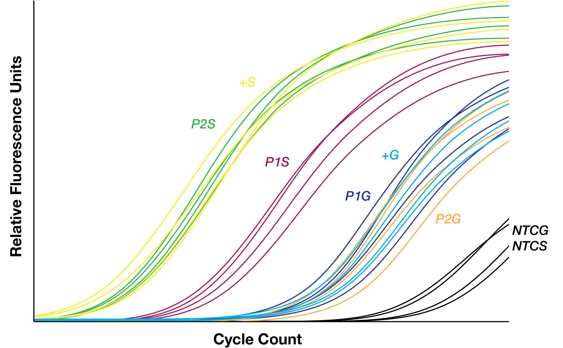
Anticipated Results — Amplification
Instructor Preparation
Sample | DNA source | Label
Positive control, SARS-CoV-2 | Crime Scene DNA | +S
Positive control, GAPDH | 10,000-fold dilution of Suspect D | +G
Patient 1, SARS-CoV-2 | 100-fold dilution of Crime Scene | P1S
Patient 1, GAPDH | 10,000-fold dilution of Suspect D | P1G
Patient 2, SARS-CoV-2 | Suspect C | P2S
Patient 2, GAPDH | 10,000-fold dilution of Suspect D | P2G
No template, GAPDH | N/A | NTCG
No template, SARVS-CoV-2 | N/A | NTCS
Notes:
These are simulated reference amplification curves to assist with interpreting student results. Both patient 1 and 2 are positive for SARS-CoV-2, however patient 2 has a higher quantity of viral RNA. GAPDH successfully amplified for both samples. Since GAPDH is derived from the patient DNA, its quantity does not scale with the quantity of viral RNA. The no template samples show signal at higher cycle counts because of the formation of primer dimers. Other samples, which consume primers through template amplification, will form fewer primer dimers.

Slide 11
Scenario
The CDC currently recommends a SARS-CoV-2 real-time PCR detection method that uses a TaqMan probe, which produces results quickly. Some SARS-CoV-2 detection kits using TaqMan have come under scrutiny for false positives and other problems leading some researchers to pursue other PCR methods.
You are working in a lab using a prototype SARS-CoV-2 detection protocol based on the results of Park et al. The protocol uses a two-target multiplex approach and includes GAPDH as a control locus.
Park, M., Won, J., Choi, B.Y. et al. Optimization of primer sets and detection protocols for SARS-CoV-2 of coronavirus disease 2019 (COVID-19) using PCR and real-time PCR. Exp Mol Med 52, 963–977 (2020). https://doi.org/10.1038/s12276-020-0452-7
Notes:
The majority of SARC-CoV-2 PCR based detection assays use a TaqMan like probe in a qPCR protocol. The Crime Scene Investigator PCR Basics Real Time Starter Kit includes a SYBR-based probe.
This scenario is designed to reconcile the nature of the kit with the reality of detection methods. If needed, adjust the scenario for whatever suits your students.

Slide 12
Your Task
Two patients from a single family were brought to a local clinic with COVID-19 like symptoms. Nasopharyngeal swabs were collected from both samples. Another member of your lab has already isolated RNA and used reverse transcriptase to generate complementary DNA.
Determine whether these patients are positive for SARS-CoV-2 using real-time PCR.

Slide 13
Procedure
Set up the following PCR reactions using two master mixes:
MMS — Master mix with SARS-CoV-2 primers (2 loci)
MMG — Master mix with GAPDH primers
PCR Tube | DNA Sample | Master mix | Reaction
NTCS | 12.5 µl water | 12.5 µl MMS | No Template Control – SARS-CoV-2 primers
NTCG | 12.5 µl water | 12.5 µl MMG | No Template Control – GAPDH primers
+S | 12.5 µl +S | 12.5 µl MMS | Positive Control – SARS-CoV-2 primers
+G | 12.5 µl +G | 12.5 µl MMG | Positive Control – GAPDH primers
P1S | 12.5 µl P1S | 12.5 µl MMS | Patient 1 – SARS-CoV-2 primers
P1G | 12.5 µl P1G | 12.5 µl MMG | Patient 1 – GAPDH primers
P2S | 12.5 µl P2S | 12.5 µl MMS | Patient 2 – SARS-CoV-2 primers
P2G | 12.5 µl P2G | 12.5 µl MMG | Patient 2 – GAPDH primers

